Slide 1
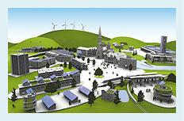
Module 4:Community Energy in Action

Slide 2
Energy Community of Practice Resources
The Ontario Energy Community of Practice (ECOP) focuses on providing education and capacity building for Ontario municipalities, utilities and other local stakeholders to develop and implement community energy plans, and helping connect local, regional and provincial energy planning initiatives.
ECOP Module 1: Community Energy Planning Benefits and Applications
ECOP Module 2: Community Energy Planning within the Broader Provincial Energy Planning Framework
ECOP Module 3: Community Energy Plan Implementation
ECOP Module 4: Community Energy in Action
http://www.questcanada.org/events-projects/research/ecop
Notes:
The Energy Community of Practice has developed a number of resources to help municipalities and their stakeholders raise energy literacy and to advance local conversations of what community energy can do for your community. The goal of this module is to provide a bit of a tour of community energy projects already in action across Ontario and Canadian communities in order to help move the conversation from planning towards what community energy in action could like within that community.

Slide 3
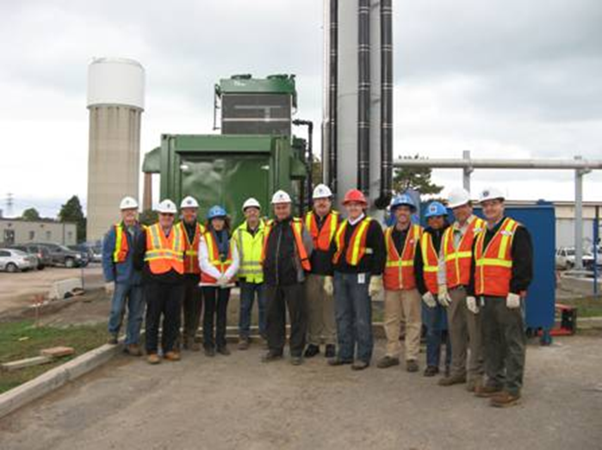
City of Hamilton Cogeneration at Woodward Wastewater Treatment Plant
Woodward Wastewater Treatment Plant
BioGas Storage in Globe
BioGas Purification Unit
Notes:
The City of Hamilton has been in the community energy game for quite some time. To get their “own house in order” in 2007 Hamilton City Council adopted a corporate energy policy to facilitate energy reduction actions and adopted a corporate energy reduction target (20% by 2020 energy reduction in City owned facilities and operations) as well as an energy monitoring and reporting and financing framework.
In 2006, the City opened a 1.6 MW cogeneration facility at the Woodward Wastewater Treatment Plant which takes methane gas created by the wastewater treatment process and produces electricity and heat.
Then in 2008, the City began operating a 3.2 MW cogeneration facility at the Glanbrook Landfill by collecting landfill gas to generate electricity.
In 2015 Hamilton expanded their use of bio gas by purifying it and feeding it into the natural gas grid to contribute renewable natural gas into the system.
Hamilton is currently exploring opportunities to use bio gas generated from their green bin program.
Annual Benefit to City from these facilities is in the range of ~$1.6M to $2M.

Slide 4
Hamilton District Energy
Notes:
Hamilton has also developed a district energy system in their downtown core. Hamilton Community Energy provides heating and cooling to commercial, residential and institutional buildings via a natural gas powered 12.5 MW thermal capacity that uses 3 sterling hot water boilers and 3 chillers that also generates 3.5 MW of electricity.
Some of the key drivers for customers include: reduced greenhouse gas emissions; reduced day to day operating costs; elimination of on site heating and cooling equipment; protection against energy price increases; reduced liability; insurance savings; and additional space.
The district energy system can be expanded to incorporate more buildings as the market expands. This incremental growth reduces the upfront capital costs and can expand the growth occurs and the market expands.
For example (picture on right) in 2010 HCE partnered with McMaster Innovation Park to connect the district energy system to a geo-exchange system of 81 500 feet geo wells connected to the CANMET Materials Laboratory solar thermal technology and heat pumps. It is anticipated that about 80% of the thermal energy needs will be met by the geo-exchange system with the district energy providing the remaining thermal needs.

Slide 5
City of Hamilton’s Corporate Energy Actions & Energy Revolving Fund
Notes:
The Municipality’s own operations are also part of the community. As part of Hamilton’s Corporate Energy Policy an Energy Reserve was set up whereby energy savings and incentives were allocated to the energy reserve to provide the capital required to achieve further energy and financial savings. This provides a snap shot of the City of Hamilton’s avoided costs, energy conservation and incentives and cost recovery outcomes.

Slide 6
City of North Vancouver District Energy System
Notes:
The City of North Vancouver is a small urban city with a population approaching 50,000 and covers an area of 11 square kilometers
In the 1990’s the Lower Lonsdale area (an area of about 300K square metres) was being redeveloped, district energy was recognized as an efficient and cost effective way to provide heat and hot water.
The Lonsdale Energy Corp now has six miniplants serving customers in the Lower Lonsdale, Central Lonsdale, and Marine Harbourside areas. LEC’s miniplants use a combination of high efficiency natural gas boilers, ground source heat pumps, heat recovery from building cooling, and solar thermal panels to heat hot water. The hot water is circulated through a series of underground insulated pipes, providing energy for heating and hot water to residences and businesses.
The use of a number of smaller plants has enable the system to grow as development occurred and thereby enabled the careful staging of capital outlays.
Lonsdale Energy Corporation is wholly owned City’s corporation and utility and retains municipal exemptions and Council control of rates and regulations.
LEC presently uses a combination of high efficiency natural gas boilers, ground source heat pumps, heat recovery from building cooling, and solar thermal panels to heat hot water. Heat from natural gas boilers is supplemented with energy from a number of alternative energy projects, including heat pumps that pull heat from the ground, heat pumps that use the heat rejected from cooling buildings, and solar thermal panels installed on the City Library. LEC is continually exploring ways to use waste heat from buildings and industrial processes located adjacent to the district energy system, and switching to alternative and renewable fuels. This move is already underway in Central Lonsdale where LEC's mini-plant is powered by solar energy.

Slide 7
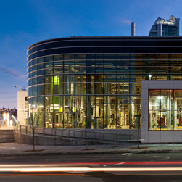
Calgary District Energy, ENMAX
Notes:
In 2006, the City of Calgary set a target to reduce greenhouse gas (GHG) emissions by 50 per cent below 2005 level by 2050. ENMAX Corporation built the Downtown District Energy Centre (DDEC) in part to align with The City's ghg reduction targets. The DDEC currently heats several commercial and residential buildings in Calgary's downtown, including City Hall and The City-owned Alberta Trade Centre and Andrew Davison building.
The City of Calgary introduced policies that encourage and support the use of district energy, including commitments made in the 2012 Calgary Community GHG Reduction Plan and a new Centre City Downtown Bylaw that provides incentives for Green Building features such as district energy and combined heat and power connectivity.
Pictures: top left (district energy area); Top right (district energy building); bottom right (building heating provided by de); bottom left (district energy pipes)
Water is first heated by natural gas and then travels through a thermal pipe system. The centre supply’s thermal energy to customers including The City of Calgary Municipal Building, the Andrew Davison Building, Hillier Block Building, and Bow Valley College.

Slide 8
City of Markham District Energy System
Notes:
Markham District Energy’s system has been in operation since 2000 and has attracted major investments to Markham including IBM and Bell
Markham District Energy reduces greenhouse gas emissions in the urban centres it serves by 50%.
In the event of an emergency, Markham District Energy’s combined heat and power system has the capability to maintain power and heat to over 4 million square feet of selected buildings in Markham Centre including its regional hospital, two high schools and a community centre.
The combined heat and power system (CHP) comprises three high-efficiency natural gas-fired boilers with a total capacity of 12.0 MWt and cooling capacity of 4600 tonnes which includes two 1100 tonne and three 700 tonne electrically driven centrifugal chillers and one 300 tonne hot water absorption chiller.

Slide 9
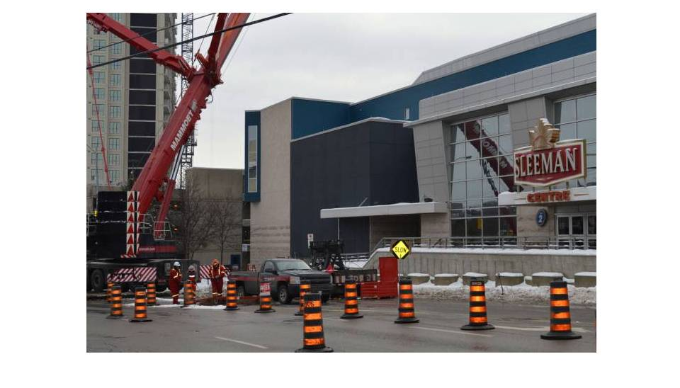
City of Guelph District Energy
Notes:
In 2014 a thermal energy plant in the Sleeman Centre downtown arena went into commercial operation, creating the Galt District Energy System that uses natural gas to heat water in boilers for space heating, and it has a central chilling unit to chill water for cooling.
Shortly thereafter the Tricar Group signed a contract with Envida for this plant to supply heating and cooling for the River Mill condominium project.
The district energy system in the Hanlon Creek Business Park started serving its first customer in April 2014.
Inventory of all the District Energy Projects in Canada 2013
https://www.cieedac.sfu.ca/DB_DEnew/DEFinal2015.pdf

Slide 10
City of Guelph, Community Energy Plan
Notes:
The District energy system was a key action in Guelph’s Community Energy Plan. This plan outlined a comprehensive roadmap to 2031 that ensured the City provided clean and competitive energy services to a population expected to grow by 50% to 175,000.
As part of the District Energy Strategic Plan, the goal is to have at least 30 per cent of Guelph’s anticipated total electricity requirements will be associated with Combined Heat and Power (CHP) or other forms of local generation.
The District Energy System is just one of the many actions identified as a priority within Guelph’s Community Energy Plan.

Slide 11
False Creek, City of Vancouver
Notes:
Uses waste heat from the sewage treatment plant to provide space heating and hot water to the residents of False Creek Neighbourhood. Currently, they are connected to 4,389 residential suites and has saved a total of 10,000 tonnes of CO2 emissions.
The project commenced in 2010
http://vancouver.ca/home-property-development/southeast-false-creek-neighbourhood-energy-utility.aspx

Slide 12
Saanich, BC: Heat Recovery District Energy
Notes:
Saanich’s renewable energy heat recovery project captures the thermal energy from wastewater effluent and circulates it through a district energy system to heat a swimming pool at the district's Panorama Recreation Centre, the treatment plant, an adjacent greenhouse facility and an elementary school. Saanich committed to having the municipal operations be carbon-neutral by 2012 under BC's Climate Action Charter by reducing energy use for its operations and increasing its use of renewable energy.
The renewable energy system replaces natural gas heating for the pool. The project cost 3,3 million and replaces $112K in annual natural gas costs. ROI is estimated at 15 years based on current natural gas prices.
http://www.fcm.ca/home/awards/fcm-sustainable-communities-awards/past-winners/2013-winners/2013-energy-projects-co-winner-1.htm

Slide 13
City of Toronto, Deep Lake Water Cooling
Notes:
Cold water is taken from the Lake Ontario depths into the intake pipes which enter the Toronto’s district energy system providing cool air for air conditioning systems within the downtown core. (Air conditioning is one of the most expensive uses of electricity, this cooling system reduces the peak load demand) reducing the cooling load for the Toronto grid will help reduce the overall energy prices, especially during peak energy periods.
The system uses 85 million kilowatt-hours per year less than conventional cooling systems or roughly the amount of power required to supply 6800 homes a year.
A key message conveyed to potential customers was that the project offered long-term price stability (insulated from price hikes for electricity or gas) and reduced maintenance costs. Making this business case meant developing a rapport with customers, from the building manager to the senior decision-maker.
Three intake pipes each reaching 5 km into Lake Ontario bring cold water (4°C) from 83 metres below the surface of the lake to the City of Toronto’s water filtration plant. The pipes are made from high-density polyethylene and are held in place on the bottom of Lake Ontario using concrete collars. Close to the shoreline, they are buried in the beach sand to prevent damage from wind and wave action and ships. The pipes are routed to the City’s water intake and filtration plant on Toronto Island, and from there to the John Street pumping station.
http://www.districtenergy.org/assets/CDEA/Case-Studies/Enwave-case-history-Toronto7-19-07.pdf
https://crcresearch.org/case-studies/case-studies-sustainable-infrastructure/energy/deep-water-cooling

Slide 14
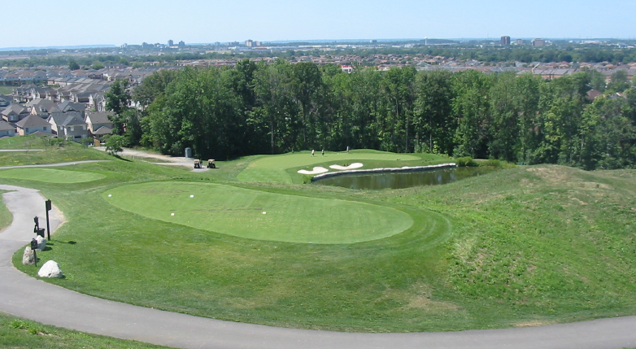
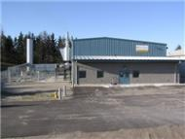
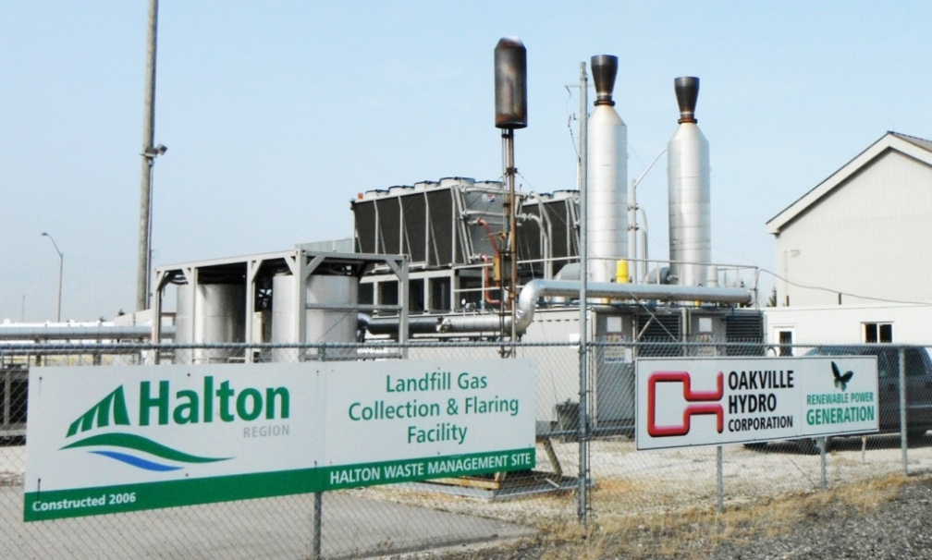
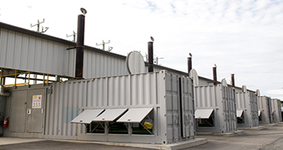
Landfill Gas to Electricity
Notes:
Pictures: (starting at bottom left and going clockwise) Guelph; Moose creek Ottawa; Britannia in peel Region; Halton
Landfill Gas (LFG) generation projects use proven technology and are common in Europe and North America. Projects in Ontario that are similar to the proposed LFG generation project include:
Beare Road Landfill, Toronto (1996, 5.7 MW)
• Waterloo Landfill (1999, 4.6 MW)
• Brittania Road Landfill, Mississauga (5.5 MW)
• Aurora Landfill (2005, 1.1 MW)
• Trail Road Landfill, Ottawa (2006, 5.3 MW)
• Eastview Landfill, Guelph (2006, 2.4 MW)
• Halton Region Landfill (2007, 2.1 MW)
• Blackwell Road Landfill, Sarnia (2007, 1.6 MW)
• Sudbury Landfill (2007, 1.6 MW)
• East Landfill, Niagara Falls (2007, 1.0 MW)

Slide 15
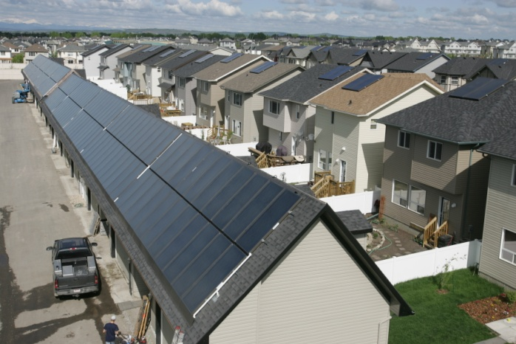
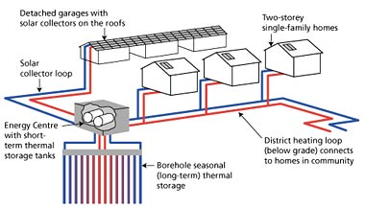
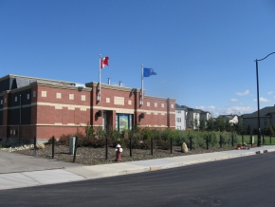
Drake Landing Community, Okotoks, Alberta
Notes:
The community primarily uses solar thermal energy for space cooling/heating and hot water. The result is an overall reduction on the dependency of natural gas. Another example of how the district energy system was able to reduce the overall dependency on natural gas. There is a challenge to make a business case to transfer our dependency from natural gas to electricity since natural gas is so cheap. These examples are great case studies to learn how we can make this transition possible.
Drakes Landing is a community of 52 homes powered by an integrated system of solar thermal panels on garages, underground net-works, short-term (STTS) and long-term (BTES) energy storage facilities, two different types of housing energy and water efficiency standards, and the additional genius of having real-time information on how efficient this community is through their website and/or cell phone app.
The thermal energy collected from the solar panels is used to heat a glycol solution that travels from the solar panels, through underground isolated trenches into the energy storage facility. The glycol passes through a heat exchanger that transfers the thermal energy from the glycol into water tanks. The water tanks heat up and stay hot for long periods of time. During the night time, the glycol would travel from the heated water tanks and into the homes. The excess heat that is not being used by the homes gets transferred from the short-term thermal storage to the Bore Hole Long-term energy storage, where 144 holes run 37m long below the ground 35 m in diameter. The holes allow for the hot water to run through and heat the surrounding soil, which contains a mixture of sand, clay, high density R4 insulation, water proof membranes and other landscaping materials to ensure the thermal energy does not escape as this thermal energy will be used in the winter months. During the winter months, the heat from the BTES is used to heat the water running through the holes to heat the STTS which would then heat the glycol travelling back to the Drake Landing homes.
The solar panels are able to meet 90% of the homes space heating needs, and cover 60% of the occupant’s hot water requirements. This means is that it is resilient enough to tackle -33 C temperatures in the winter and 28.3 C in the summer using the power of the sun. The efficiency of the houses combined with the solar energy components is so efficient that it uses 30% less energy than that of a conventional Canadian home. If the energy demand of the houses surpasses the energy supply within the STTS and the BTES, then there is a backup gas generator just in case.

Slide 16
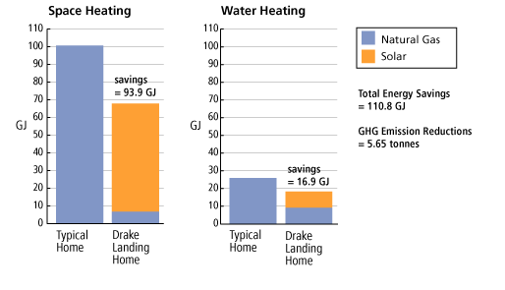
Drake Landing Community, Okotoks, Alberta
Notes:
See notes on previous slide

Slide 17
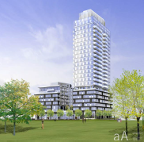
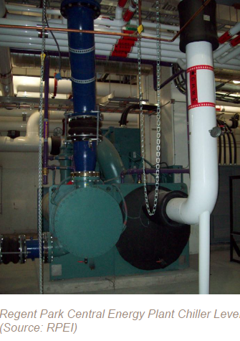
Toronto Regent Park
Notes:
The Regent Park Community Energy System (RPCES) is a hot water district energy system, in Regent Park, Toronto, Ontario. Regent Park is one of the oldest & largest social housing project in Canada. It covers an area of 69-acres in east downtown Toronto. It was originally home to 7,500 people and now following a $1billon transformation it is a mix of residential (market & social housing), commercial, retail & institutional spaces and will be home to a mixed community of 12,500 people. The focus is on both improved livability & sustainability
The central energy plant is located below grade, in the basement of 252 Sackville Street – a 22-storey TCHC residential high rise, which was the first new building in the Revitalization. When the Toronto Transit Commission closed down a busy street to replace streetcar tracks in 2007, this window of opportunity was used to install part of the DPS for Phase 2.
The Energy Centre commenced operation in 2009 serving Phase 1. At build-out, the Energy Centre will generate 30 MWt of heating and 4,500 tons of cooling, with provision to incorporate a variety of energy sources. There will be 4 trench kilometres of buried 4-pipe DPS and ETS for heating and cooling in each building.

Slide 18
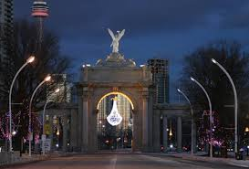
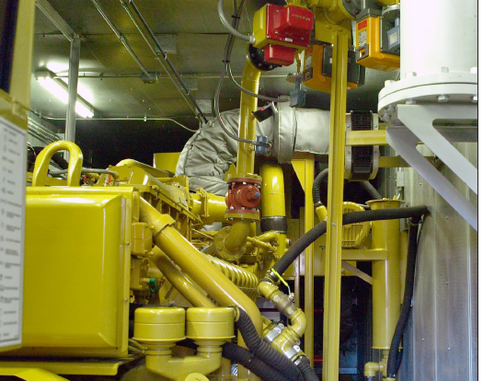
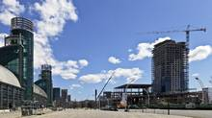
Toronto Exhibition Place
Notes:
Toronto Exhibition Place has been in the Community Energy Action game for quite some time.
From left: Wind turbine aka Windy to Gaby and her kids; top middle: solar PV – horse palace; top right: LED Street lighting pilot project; bottom middle: CHP installation - direct energy centre; bottom right: District energy being expanded into hotel and other buildings.

Slide 19
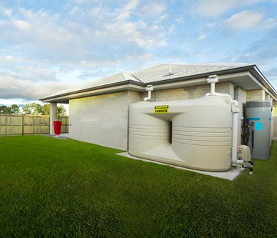
Town of Newmarket LEED Platinum Development
Notes:
EcoLogic was the first development in Canada to be built entirely to Leadership in Energy and Environmental Design (LEED) Platinum specifications. The Town of Newmarket was the catalyst for the project and selected Rodeo Fine Homes as the builder of this co-operative development. The development takes place on former Town land and a condition of the sale was the sustainability commitment on the part of the developer.
Construction on the 34-unit EcoLogic community began in 2008. The EcoLogic subdivision is made up of homes that achieve and exceed specific environmental targets, including a 50 per cent reduction in household water draws, a 35 per cent reduction in overall discharge flows and a 60 per cent reduction in solid waste, greenhouse gas production and energy consumption compared to conventional homes. In order to achieve these reductions the houses include a rain water harvesting cistern to supply toilets and irrigation, solar thermal water and air pre-heat panels, dual-purpose high efficiency boiler, integrated HRV and air handler with ECM motor, HEPA- filtration system, increased insulation levels with spray foamed above grade walls and mineral wool insulation below grade, ENERGY STAR windows, appliances, efficient lighting, FSC wood products and lumber, low VOC materials, cabinets and paints, permeable driveways and drought tolerant plants.
For more information, see Rodeo Fine Home’s Website
Watch a 3 part video series by GreenHomeTV Part 1 – Tour of Newmarket EcoLogic Homes by Rodeo Fine Homes Part 2 – Tour of Newmarket EcoLogic Homes by ﻿Rodeo Fine Homes Part 3 – Tour of Newmarket EcoLogic Homes by Rodeo
http://www.fcm.ca/home/awards/fcm-sustainable-communities-awards/past-winners/2010-winners/2010-buildings-%E2%80%93-co-winner-2.htm
http://www.fcm.ca/Documents/case-studies/GMF/2010/Newmarket_Eco_Homes_EN.pdf

Slide 20
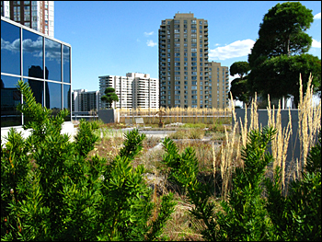
Toronto, Vaughan, Richmond Hill, Brampton & Halton Hills Green Development Standards
Notes:
Pictures: left - Photo of the green roof at ESRI Canada Ltd; right - Richmond Hill sustainability metrics brochure
Since the mid 2000’s a number of municipalities have developed green development checklists and/or incentives (usually in the form of development fee rebates) but the uptake of green measures from the development community was not as significant as was hoped for. In 2006 East Gwillimbury implemented a mandatory standard that required Energy Star for new homes and a commitment to pursue a Leadership in Energy & Environmental Design (LEED) standards for all new industrial, commercial, and institutional developments in the Town. In 2007 Vaughan followed East Gwillimbury’s lead and mandated Energy Star for all new residential homes. In 2006 Toronto implemented their voluntary GDS and in 2010 the Toronto GDS required a mandatory Tier 1 level based on performance measurements. The Toronto GDS also includes a higher Tier 2 level that is encouraged via a development charge rebate.
Starting in 2008, Vaughan, Richmond Hill and Brampton began to work collaboratively to develop a consistent set of sustainability metrics that form the basis of their Green Development Standard that has been embedded within their planning application process and requires a minimum threshold score to be attained.

Slide 21
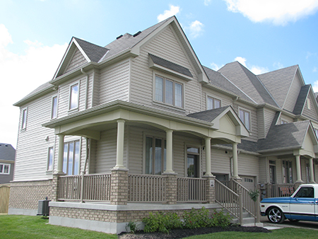
Clarington, Priority Green Home Performance Monitoring
Notes:
The Municipality of Clarington launched Priority Green Clarington which is setting a new standard for residential development in the Municipality, prioritizing innovative, sustainable development that improves quality of life for community members.
One way in which Clarington seeks to promote sustainable development is through its Green Demonstration Project. This Project is a partnership between the Municipality, three residential builders and the Region of Durham, and has led to the construction of six demonstration homes that incorporate green building techniques and technologies. The homes are efficient in their use of water, energy, and material resources, with reduced operating costs and reduced demand on energy and water infrastructure as compared to a similar home constructed to the Ontario Building Code requirements.
The homes have been sold to home owners, who, supporting the initiative, are allowing for performance monitoring of the homes to be undertaken under real-life conditions. Performance monitoring allows for the evaluation of economic, environmental and social benefits to this approach to home building. Through this Project, local developers, decision makers and community members will have an improved knowledge of green home building practices and increased capacity to build green, while the Municipality can demonstrate its commitment to sustainability and innovation. The results and lessons learned from Clarington’s Green Demonstration Project will increase the collective knowledge on the opportunities to monitor and improve the performance of green homes.
Preliminary data based on the first four months of performance monitoring shows:
• Water efficiency improvements of 8 – 17% and energy efficiency improvements of 9 – 12% over models of
comparable homes built to the minimum Building Code specifications.
• Average daily water consumption of 119 litres per capita per day, which is well below the current Region-wide
average of 230 litres per capita day.
• Average monthly electrical consumption of 468 kilowatt hours per month, as compared to a typical average of
800 kilowatt hours per month for a family of four in Ontario.
• Building on the work of Clean Air Council members, the Municipality is considering the opportunities and
challenges of “regionalizing”.

Slide 22
Net Zero Ready and Net Zero Housing
Notes:
The idea of a Net Zero Energy (NZE) home is that it employs enhanced energy efficiency design strategies to cost effectively reduce energy needs, while supplementing with renewable energy technologies, with the result that the building produces at least as much energy as it consumes on an annual basis. The project completed 26 Net-Zero housing across Canada.
(Reid Hertiage Homes (Guelph, Ontario), Minto (Ottawa, Ontario), Mattamy Homes (Calgary, Alberta), Provident (Halifax, Nova Scotia) and Construction Voyer (Laval, Quebec) were honored for their work alongside Natural Resources Canada (NRCan) and Owens Corning Canada, both leaders in the project.)
This project will assess and resolve challenges in relation to site planning, construction, equipment, grid connections, cost, trade capability, warranty, reliability, sales, marketing, and homebuyer information/education. The CHBA has developed an Net Zero label for homes in order build the capacity of the sector to respond to energy reduction goals and to build and ensure the quality of the market.

Slide 23
City of Toronto and The Atmospheric Fund Tower Wise Program
Notes:
The TowerWise Retrofit Project financed and implemented energy efficiency upgrades in seven Toronto Community Housing buildings across Metro Toronto, Scarborough, Etobicoke, and North York. In addition to expected greenhouse gas reductions of 30%, the project will be complimented by a slew of other benefits.
Retrofits undertaken include: low-flow faucets and toilets, high efficiency boilers, double-glazed windows, and LED lighting.
The financing for TCHC is structured as an Energy Savings Performance Agreement. TAF provides all of the capital up front and shares utility cost savings with TCHC over ten years. The retrofits will be financed from the TAF endowment and a low-interest loan secured from the Federation of Canadian Municipalities (FCM). Utility incentives for verified conservation measures will be secured once the project is completed.
The City of Toronto also uses the LIC financing model to finance energy retrofits of Toronto private apartments that would greatly benefit from energy efficiency measures to reduce their energy requirements and costs.

Slide 24
City of Toronto Home Energy Loan Program
Save Energy. Save Money. Live Green.
Notes:
In Toronto energy costs amount to over 4.5 billion each year. With over 80% of that leaving the community. Buildings account for a significant component of community energy use.
Energy efficiency represents an opportunity to reduce vulnerability to energy price increases. Grants and Rebates: Have the issue that they are a fiscal drain and have the free rider problem. Local Improvement Charge Financing has the benefit that it is revenue neutral, provides access to capital and can target deep energy retrofits . Deep retrofits needed but have longer paybacks (8 – 15 years). Owners think of selling and are reluctant to lower the bills of subsequent owners
The LIC Financing Option: Local Improvement Charges (LICs) are an existing infrastructure financing approach available to cities. Regulations were amended in fall 2012 to: Expand use of LICs to work on private properties based on consent of property owner. Improve flexibility in use of LICs for energy & water conservation as well as renewable energy.
The HELP program was Launched in Summer 2014 $20M capital spending targeting 1000 single family homes and 10 apartment buildings.
The LICs are transferable and can be paid at any time w/o penalty. Requires audit and is self managed by property owner
http://www1.toronto.ca/wps/portal/contentonly?vgnextoid=7e00643063fe7410VgnVCM10000071d60f89RCRD

Slide 25
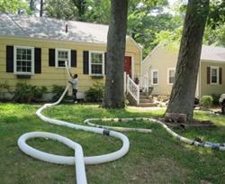
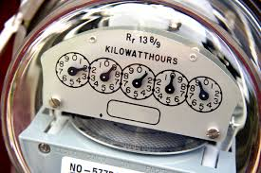
City of Guelph GEERS Program (in development)
Notes:
The City of Guelph is exploring the delivery of a comprehensive residential energy efficiency retrofit program that would provide a turn-key approach to undertaking home energy retrofits. They are exploring the use of an LIC financing mechanism to provide through that program.

Slide 26
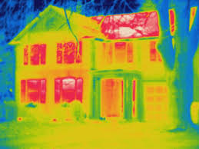
My Heat: Available in Aidrie, Calgary, Edmonton, Okotoks, Sherwood Park
Notes:
MyHeat
The MyHEAT project is an online Energy Efficiency Engagement Platform that provides a new and innovative way to engage home owners with personally relevant information about their home’s efficiency. The MyHEAT Platform consists of an interactive town map, which through aerial thermal infrared imagery, indicates each single detached home’s HEAT Score (a measure of building envelope inefficiency). The high-resolution colourized image of each home will highlight the locations within the home that have the highest heat loss and that may require further investigation by the homeowner. Additionally, the HEAT Score provides homeowners with the opportunity to compare their home to other homes of the same size and age and against the community mean. The platform also provides a mechanism to link up energy efficiency programs and services to clients.

Slide 27
Ile-Des-Chenes, Manitoba: Community Centre Geothermal
Notes:
Population: 5,000
The construction of an energy-efficient community centre that includes an arena (because we live in Canada that really should go without saying). The arena is expected to reduce its annual energy costs by about 40 per cent through the use of a geothermal system. To improve the business case the community centre teamed with other projects to design a bigger system and attract more funding. The result is Manitoba's first district geothermal heating and cooling system that connects the arena, fire hall and community centre.
The community centre houses; the town offices, features a 500-seat banquet hall, and a daycare centre that can accommodate 94 children. It also has a retail area devoted to essential medical services, including doctors’ offices and a pharmacy. The refurbished arena and new community centre have already created new jobs and the two developments are expected to stimulate economic development as the town grows to accommodate residents moving out from nearby Winnipeg.
Île-des-Chênes is located about 27 kilometres southeast of Winnipeg, in the Rural Municipality of Ritchot.
The geothermal system was installed under the parking lot and consists of 504 holes about 18 metres deep with two lines per hole. In total, the system has more than 18,000 metres of line that contain glycol. The glycol extracts heat from the ground in winter and disperses heat into the soil in summer. Pumps in the three facilities draw the glycol into the buildings where converters complete the exchange, providing heat or air conditioning.
http://www.fcm.ca/home/awards/fcm-sustainable-communities-awards/past-winners/2012-winners/2012-energy-co-winner-1.htm

Slide 28
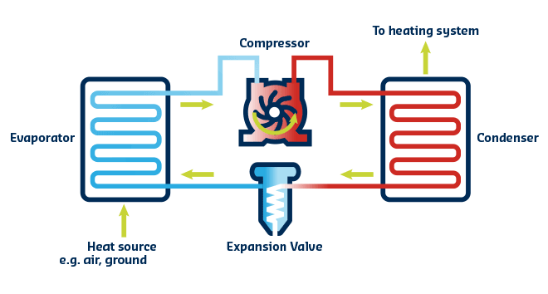
The Atmospheric Fund, Heat Pump Business Case
Notes:
The goal of the Pumping Energy Savings project is to demonstrate the business case and provide tools and resources for others to implement heat pump retrofits, specifically in electrically-heated multi-unit residential buildings aka as EMURBs. TAF’s research team has conducted an EMURB market assessment, and over the next two years will provide financial and technical feasibility studies, research on the GHG reduction potential, retrofit guidelines and financial analysis tools for market stakeholders, and recommendations for conservation programming and scale-up.
The initial study has found promising evidence that electricity consumption for heating EMURBs is big. 13% of annual electricity consumption for all multi-unit residential properties in Ontario is just for electric space heating. That means that if we retrofitted every EMURB with heat pumps, even with conservative savings estimates (60%), we would achieve 1.2 TWh of annual energy savings, 17% of Ontario’s 2020 conservation target.
Some key findings*
24% of Ontario’s multi-unit residential building stock is electrically-heated.
1,921 GWh/year is the total electricity consumed for space heating in EMURB sector.
Electric resistance baseboards are the most common heating equipment found in EMURBs.
On average, 42% of electricity use in EMURBs is for space heating; and as much as 65%.
Four key market segments were identified for targeted heat pump retrofit programming. Large bulk-metered rental apartment buildings with electric resistance baseboard heaters are the top market segment.
Stakeholder perceptions
Interviews with key stakeholders revealed a number of insights including:
Heat pump retrofits in EMURBs have been identified by LDCs as a potential growth area.
A lack of technical and financial data remains a key barrier to heat pump retrofits.
Demonstration projects and case studies would help build market confidence.
Direct financial incentives would be the most effective method for motivating property stakeholders to participate in an electric heating system retrofit.
Investor interest for heat pump retrofits in EMURBs could be bolstered with guidelines for how to structure deals and what items each stakeholder will need to consider, negotiate and agree on.
Looking Ahead
The next project phase will be to conduct feasibility studies on eight ‘typical’ EMURB properties. A current barrier to retrofitting EMURBs is the current lack of real world examples. Although geothermal and air source heat pumps are proven technologies that are becoming more common place in newly constructed properties, retrofit examples are few and far between. Eight properties will be selected to participate in a study to assess the technical and financial feasibility of retrofitting their electric heating system with either air or ground source heat pumps. The goal is to generate valuable data that can demonstrate the viability of heat pumps compared to electric heating, what heat pump solutions are conducive to various EMURB property types, and how to go about implementing the heat pump retrofit scenarios identified as being the most technically and financially feasible.

Slide 29
City of Markham, Solar PV
Notes:
There are ample examples of municipal facilities that have Solar PV panel on their roofs generating clean, renewable electricity and feeding it into the grid. What is often forgotten is that no one really know what is on the roof of municipal facilities and this often leads to a missed educational opportunity. Markham tried to address this by creating a web page complete with real time tracking and a interactive and informative kiosk in the lobby of their City hall.

Slide 30
Region of Waterloo Solar PV
Notes:
Another example of a municipality that has installed PV panels on their facilities. The key message to take home from these examples is: how and what are the best ways to spread awareness of the renewable energy being generated within the community to get community members excited about implementing more and/or their own PV system.

Slide 31
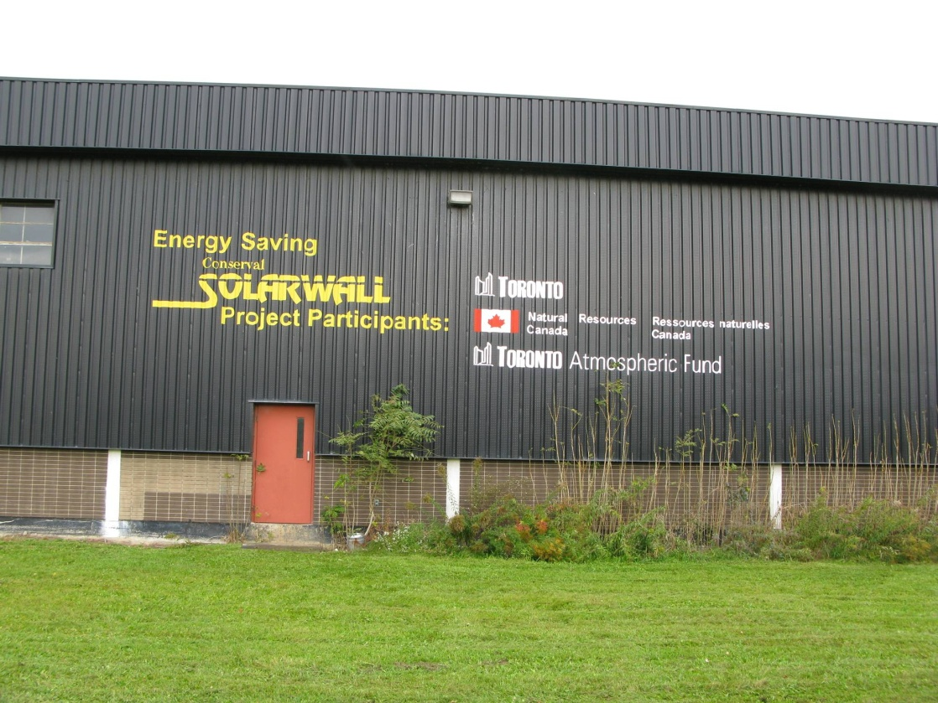
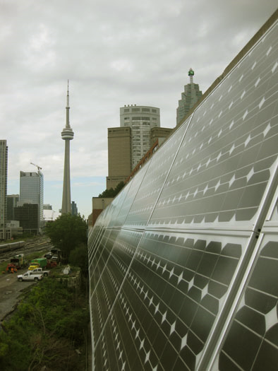
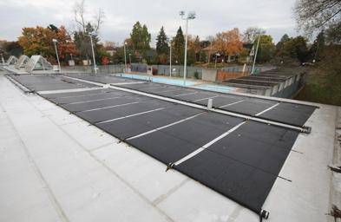
Toronto Solar City
Notes:
Highlights and provides best practices to implement new technologies, such as solar thermal and solar walls. They have been able to address the importance of building community support for these new technologies, addressing operational issues, sharing best practices, training, and expertise to encourage other municipalities to follow suit. (Operational training when handling solar thermal is very important to address)
Testing PV and solar thermal technologies and installations
14 on City facilities dating back to 1982
Solar pool heating, solar air heating, solar domestic hot water, solar photovoltaic systems
Includes Horse Palace 100 kw PV install – largest roof-mounted in Canada when installed in 2008
6 private facilities in Toronto and the GTA
Field testing facility at Kortright in Vaughan
3 solar walls
3 City of Toronto outdoor pools
3 indoor pools owned by City of Toronto
Evaluation of the effects of snowfall on photovoltaic performance
Many solar installs appear to be underperforming – require adjustments
Pre-installation predictions of solar facility performance are often not accurate
Feed-in Tariff regulations causing major grid connection delays for PV systems – negatively affecting revenue
Site operator action can greatly effect system performance – operators’ knowledge & continuous training is critical
Better coordination is needed among contractors, site operators and facility managers to ensure systems are well designed
Monitoring is not just for data collection – critical to optimizing system performance
Best practices Guide: Provides guidance on:
Financing
Project planning
Procurement
System Design and monitoring
Installation
Operation and maintenance

Slide 32
Halifax Solar City
Notes:
The “Solar City Program” is a municipal financing initiative that promotes the installation of solar-powered water heating systems to lower energy bills and reduce water consumption.
The municipality arranged over 300 system installations in the program's first 14 months — more than the rest of Canada that year — and aims to finance 700 systems within the first two years. Designed to be simple and create economies of scale, Solar City improves purchasing power and reliability, and offers quality assurance to citizens.
Used thermal mapping to illustrate the best areas on buildings to install PV panels according to the amount of solar irradiance hitting rooftops. LICs mechanisms were used to pay for the upfront costs.
Where: Halifax Regional Municipality
Solar City's pioneering funding mechanism puts a new spin on Local Improvement Charge financing by offering Property Assessed Clean Energy (PACE) loans to individual homeowners to pay for equipment and installation. The loans are tied to the property and are paid back over time, while homeowners benefit right away from the energy savings. PACE creates a budget-neutral program that covers administrative and financing costs.
It includes education, free water conservation retrofits, an optional performance tracking system, and the first city-level solar “energy potential” map in Canada — an online resource that calculates annual solar energy potential for individual homes based on data collected through Light Detection and Ranging (LiDAR), a remote sensing technology.
http://www.fcm.ca/home/awards/fcm-sustainable-communities-awards/past-winners/2015-winners/2015-energy-program.htm

Slide 33
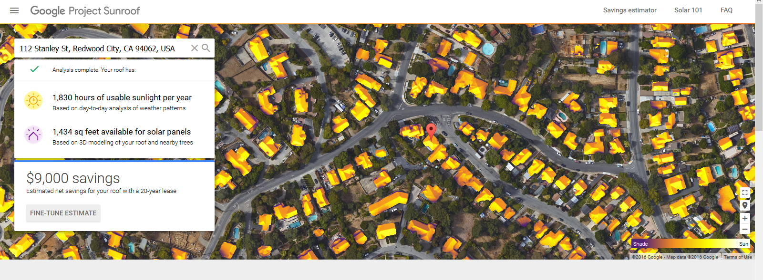
Project Sunroof by Google
Notes:
This is not available in Canada yet, but this is something that Google is doing—they are providing a solar thermal map of various states within the U.S. to illustrate the solar potential of rooftops on various buildings in order to promote solar PV nationally. Philadelphia and California have been able to use this resource to create a platform presenting local contractors in order to facilitate the installment of PV systems.

Slide 34
Project Sunroof (continued..)

Slide 35
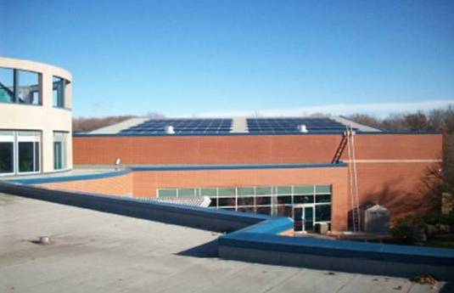
City of Burlington, Solar Thermal and Heat Recovery
Notes:
Solar thermal energy uses solar energy via a heat exchanger to pre heat water that then goes into a hot water tank to be heated up further if necessary to supply hot water to the user to be used in swimming pools, hot showers, dishwashers or any other place we like to have our water heated.
The City of Burlington in 2010 installed seasonal solar heating and a year-round waste heat recovery system at its The 90-panel solar installation covers an area of 398 m2, and is capable of supplying up to 325kW of thermal energy—roughly 25 per cent of the energy used to heat the centre‘s swimming pool. The solar hot water system also delivers heat to the pool showers when there is solar energy available and the swimming pool is at its set temperature.
The energy supplied by the solar panels is complemented by a waste heat recovery system that collects warm water from the pool‘s drains. The warm drain water is then used to heat incoming cold city water, which helps to reduce the heating load on the facility‘s natural gas-fired boiler.
The total implementation cost of this measure was $116,970. Some of these costs were funded by the Government of Canada‘s ecoENERGY for Renewable Heat Program ($11,610), the Ontario Solar Thermal Heating Incentive ($11,610), and the Electrical Retrofit Incentive Program ($28,875). As a result of this initiative, the city should expect to see annual cost savings of $28,275, with the system paying for itself in a little over two years.
The alternative energy systems will not only save the City money, but will also contribute to significant GHG reductions. The local utility provider, Burlington Hydro, estimates that the measure will save 24,138 m3 of natural gas and 101,000 KWh of electricity per year.

Slide 36
San Francisco Policy Requiring Solar Panels on New Buildings
Notes:
As a hotspot for tech companies, San Francisco is the logical home to such an ordinance, but it isn’t the first California city to enact such a requirement. Smaller cities, like the nearby Sebastopol in Sonoma County, already have similar regulations. San Francisco’s new law will become effective January 2017, requiring all new buildings in the city with 10 stories or fewer to install either rooftop solar PV or solar thermal panels. Existing California state law already outlines a requirement for all new buildings to have at least 15 percent of their roof space exposed to sunshine, in order to allow for future solar panel use, so the city’s new rule builds on that.
Related: San Francisco’s first Passive House apartment complex produces so much energy it powers its own microgrid
The city’s Board of Supervisors voted unanimously to approve the new rule. The requirement makes San Francisco the largest U.S. city to enact such a mandate. Although New York City has a host of green initiatives of its own, leaders there have stopped short of a solar panel requirement, instead opting to pass rules that require city-owned buildings to slash energy usage.
City Supervisor Scott Wiener, who introduced the rule, believes it will set an example for other large cities to get serious about renewable energy commitments and pave the way for other types of green building requirements. “In a dense, urban environment, we need to be smart and efficient about how we maximize the use of our space to achieve goals such as promoting renewable energy and improving our environment,” he said in a statement.
Via The Guardian

Slide 37
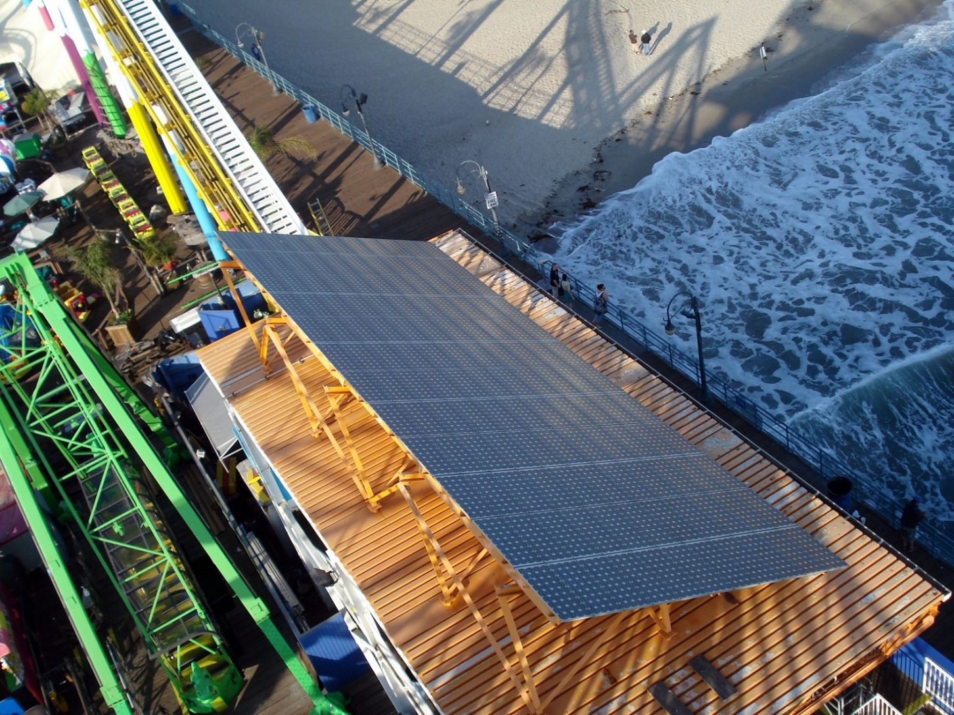
One Week Later… Santa Monica Follows
Notes:
Exactly one week after San Francisco became the largest U.S. city to require rooftop solar installations on new buildings, Santa Monica followed with similar legislation. On April 26, the Santa Monica City Council approved an ordinance requiring rooftop solar systems for all new construction — both residential and commercial.
The measure, which goes into effect the last week of May, updates the Santa Monica Municipal Green Building Ordinance to require new single family dwellings to install a solar electric photovoltaic (PV) system “with a minimum total wattage of 1.5 times the square footage of the dwelling (1.5 watts per square foot).” The measure also requires new multi-family dwellings and non-residential, hotels and motels to install a solar PV system “with a minimum total wattage 2.0 times the square footage of the building footprint (2.0 watts per square foot of building footprint).”
Images via Wikimedia 1, 2

Slide 38
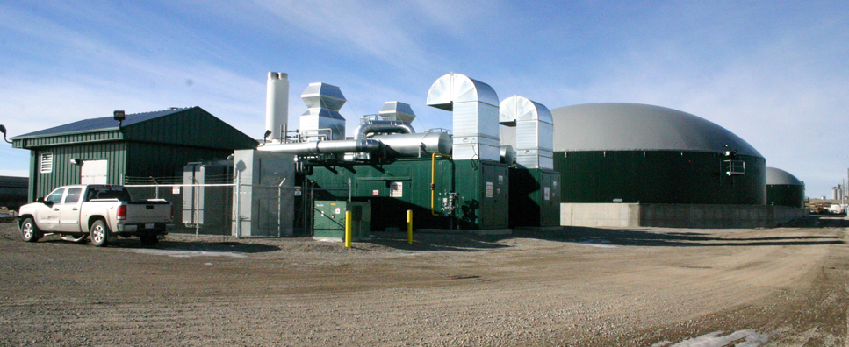
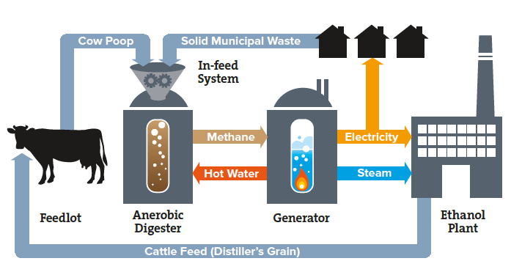
Lethbridge Bio Gas Plant, Alberta
Notes:
This Bio-Gas Plant produces about 2.8 megawatts (MW) of power, which is being sold on the province’s open market with the capacity to power 2,800 homes. The owners already plan to expand the facility by 50 percent over the next two years to produce 4.2 MW. The plant also generates about 100,000 gigajoules of thermal energy, with hot water used to heat their internal systems of 12 million liters of digestate.
The project is owned jointly by St. Catharines, Ont.-based, PlanET Biogas and Alberta-based, ECB Enviro North America Inc. The joint venture is operating as Lethbridge Biogas LP.
The biogas produced from the digesters is burned as fuel in two engines that power two electrical generators hooked into the power grid. A third engine will bring production up to 4.2 MW.
The digesters will process over 100,000 tonnes of raw material annually. More than 50 percent will come from manure collected from southern Alberta farms. Of that, the majority will come from dairy farms, with additional inputs from hog and poultry operations. The technology chosen for the project is geared toward processing liquid manure, with the ability to process a certain percentage of solid matter in suspension along with it. The goal is to achieve 95 percent consistency of the mix of digester inputs over time so that biogas production is predictable and constant.
To finance the project, the owners received $8.2 million from an organization called Climate Change and Emissions Management Corporation (CCEMC)
http://www.lethbridgebiogas.ca/

Slide 39
The UK’s First Poo-Powered Bus
Notes:
The Bio-Bus, the U.K.’s first poo-powered bus, just hit the road and is going into active service for a four-week trial period starting Monday 24 November, 2014. The 40-seater bus runs on gas generated through the treatment of sewage and food waste that’s unfit for human consumption, and produces fewer emissions than a traditional diesel engine. The bus is being run by the Bath Bus Company, covering the Bath to Bristol Airport service along the A4 motorway.
The Bio-Bus can travel 186 miles (300 km) on a full tank of gas. The gas is generated at the Bristol sewage treatment works, a plant run by GENeco, which is a subsidiary of Wessex Water. The general manager of GENeco, Mohammed Saddiq, said: “Through treating sewage and food that’s unfit for human consumption we’re able to produce enough biomethane to provide a significant supply of gas to the national gas network that’s capable of powering almost 8,500 homes as well as fuelling the Bio-Bus.”
Related: I Drove Toyota’s Mirai Future Car to a Sewage Plant and Filled it With Poo Power
According to Wessex Water, one tank of gas represents the annual waste of around five people. The company notes: “Using the annual waste generated from one bus load of passengers would provide enough power for it to travel a return journey from Land’s End to John O’Groats,” or the length of the island of Great Britain from its southernmost to northernmost extremities. Around 10,000 passengers are expected to ride the bus during the four-week trial period.
Mr Saddiq adds, “Gas-powered vehicles have an important role to play in improving air quality in UK cities, but the Bio-Bus goes further than that and is actually powered by people living in the local area, including quite possibly those on the bus itself.” This is fantastic news, though maybe you don’t want to contemplate that too deeply while you are looking around at your fellow passengers.
+ Bath Bus Company
Via The Guardian

Slide 40
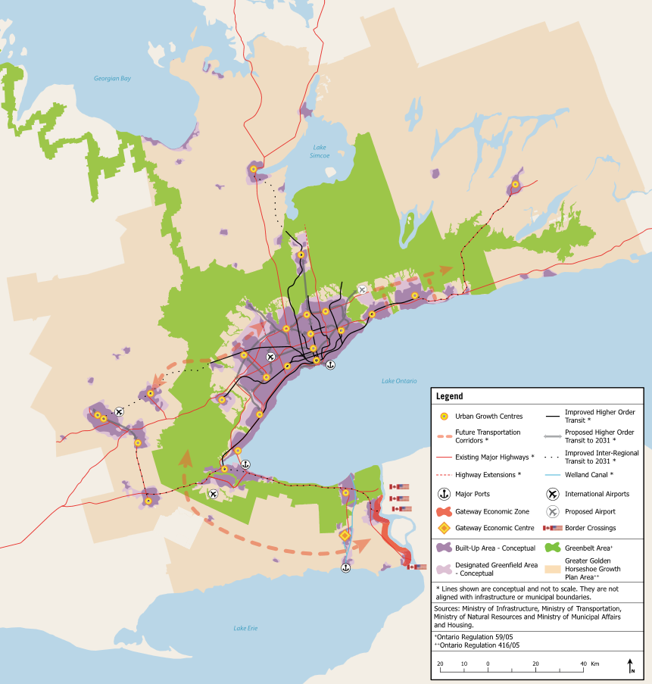
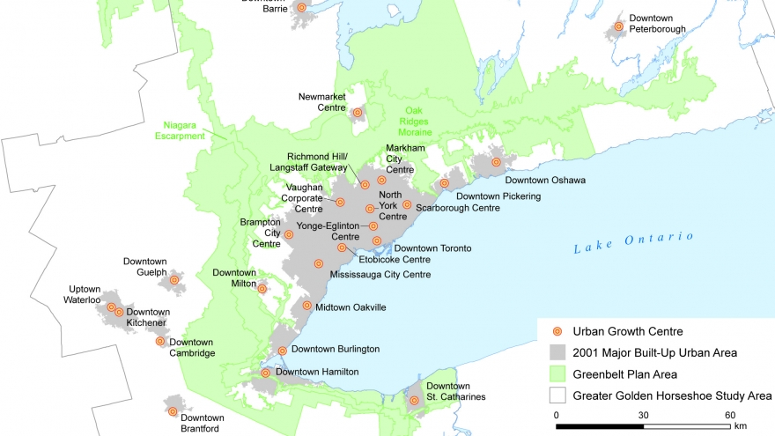
Growth Management Policies and Plans
Notes:
Growth Management Policies and Plans: are essential as land-use planning, smart growth planning policies, and active transportation plans heavily involve and incorporate energy planning (how the community grows directly affects how the much energy is needed to sustain that growth). Having examples of what these plans consist of and how they have been implemented is fundamental to the successful implementation of all these projects.

Slide 41
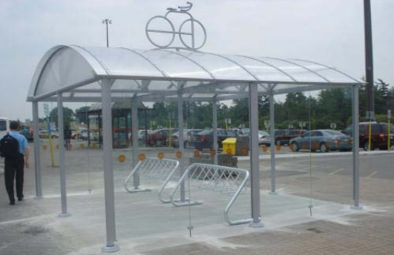
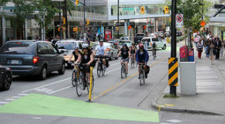
Active Transportation Plans
Notes:
http://www.tcat.ca/knowledge-centre/active-transportation-plan-scan-cac/
The Active Transportation Plan Scan for the Clean Air Council features a categorized scan of the adopted AT plans within all 27 CAC member municipalities, as well as eight additional selected Canadian municipalities (e.g. Ottawa, Montreal, Vancouver), and regional (Metrolinx) and provincial (Ministry of Transportation) plans. The majority (74%) of the CAC member municipalities have either an AT or bicycle plan. Of those that do not, one is under development (Halton), and three (Aurora, Brampton, Caledon) have trails master plans which are primarily for recreation, not transportation.
The AT scan was conducted between May 2015 and November 2015, consisting of a comprehensive search for adopted active transportation plans within the CAC member municipalities and other selected jurisdictions. Documents included in the scan were AT plans, bicycle plans, pedestrian plans, recreational trails plans, as well as the AT sections of Transportation Master Plans. The plans were then analyzed and the information categorized, specifically in relation to the following:
AT mode share targets
AT injury/fatality targets
AT infrastructure targets
AT outreach targets
The scan focused on targets because they provide specific and achievable performance levels that can be monitored and benchmarked with other jurisdictions. This is an area for improvement for most Canadian AT plans. Of the 36 jurisdictions included in the scan, 26 have AT plans and the majority (78%) of these plans include at least one target type, typically AT infrastructure targets. However, only four jurisdictions (East Gwillimbury, Guelph, Oakville, Richmond Hill) included all four of the target types in their plans.

Slide 42
Notes:
It is also important to keep in mind that how we build our roads have a huge impact on our transportation choices. Complete Streets policies and Complete Streets retrofits are not very often thought about as Community Energy but the choices we make as a municipality and a community on how we build our roads have embedded energy opportunities or obstacles. We have grown used to seeing roads being used to move as many vehicles as quickly as possible and we forget that the purpose of our transportation infrastructure is to move people not vehicles. Complete Streets policies are an opportunity to increase the equity in our transportation option to ensure as safe and as effective use of the roads for as many users as possible.
More examples of Complete Streets retrofits are available here:
http://www.tcat.ca/knowledge-centre/complete-street-transformations/

Slide 48
Where is Your Jurisdiction on its Community Energy Journey? Where Will it Go Next?
Community Energy Planning Progress Grid | Level 1 (Building Awareness and Knowledge) | Level 2 (Building Capacity, Support and Engagement) | Level 3 (Moving on to Planning, Implementation, Monitoring and Evaluation)
Beginner | Does not see municipalities playing a role in energy planning and implementation; see that as Province’s responsibility. Does not see what benefit community energy provides a municipality. | Initial communications taking place across and within departments related to the role community energy planning can play in addressing municipal priorities and issues. | Council mandate to develop Community Energy Plan. Internal buy in to benefits and engagement from council and various departments, communication and engagement of stakeholders and follow through and timeline to develop Community Energy Plan.
Intermediate | Recognizes some of the local benefits to municipal engagement on community energy related to energy efficiency benefits. Aware of provincial regional electricity plans, little coordination with stakeholders and planning being acted upon. | Review of existing Plans and identification of community energy actions/issues already identified in those Plans. Identification of gaps that need to be addressed. | Council approval of Community Energy Plan and staff and budget dedicated to implementation and progress report on implementation actions. Sharing of experiences and resources with other municipalities.
Advanced | Communications related to the benefits of community energy planning being communicated and discussed within municipality, largely isolated within one department or champion however. | Internal preparation for strategy and support for the development of a community energy plan and the goals and purpose it would serve. | Monitoring and evaluating results of community energy, integrating lessons learned into improving implementation of Community Energy Plan. Promoting the results and lessons learned of planning and implementation community energy opportunities to other municipalities and stakeholders.
Notes:
There is a progress grid available to municipalities to help them identify where the jurisdiction is on the Community Energy Journey, based on the different levels of energy-based implementation within the planning framework, and provides next steps in order to continue developing better and smarter energy-efficient projects---This resource is available at the Community Energy of Practice Hub as well. http://www.questcanada.org/events-projects/research/ecop

Slide 49
Thank You

