Slide 1
Module 1
Community Energy Planning
Benefits and Applications
www.questcanada.org/ecop
Original: October 2015
Revised: December 2016

Slide 2
Overview
1.1 Overview of Community Energy Planning
1.2 Applications of a Community Energy Plan (CEP)
1.3 Benefits of Community Energy Planning
1.4 CEP Resources
Notes:
Module 1 of the ECOP resources will focus on the rationale for why a municipality would likely be interested in pursuing a Community Energy Plan (CEP); the benefits that occur from a CEP; who the benefits incur to; why the municipality is so important in this effort; who needs to be involved; steps associated with the development of a CEP; and how it fits into overall municipal planning and decision making.
We will also explore some resources that can support its development.

Slide 3
1.1 Overview of Community Energy Planning

Slide 4
What is Community Energy Planning?
Community energy planning helps define community priorities around energy with a view to shape how energy is generated, delivered and used, now and into the future. The intention is often to:
Manage future risks and enhance resilience
Improve energy efficiency
Drive economic development
Cut GHG emissions
Notes:
It’s a good idea to start with a definition for CEP so we can all start from a common place as we travel this CEP path.
There has been some confusion related to the term Municipal Energy Planning and Community Energy Planning. They are meant to refer to the same thing and while there has been some confusion regarding the name of the MOE Municipal Energy Planning program (which we will discuss more in the resources section of this presentation), Municipal Energy Planning and Community Energy refer to the same thing.
It is important to highlight that CEPs and MEPs do not simply focus on energy planning from the perspective of the corporation of the municipality.
While how the municipality uses energy will be one component of the CEP, the CEP will go beyond that and explore how the community as a whole (including the municipality) uses energy. From the municipal corporate perspective it will bring together municipal planning and transportation departments.
It is also important to include a wider stakeholder group in the CEP including utilities, and other public stakeholders such as schools and hospitals, the commercial, and industrial sectors, business and residential associations. This will provide a more robust CEP and identify and engage others better enabling the CEP to understand and influence how the community as a whole uses energy.
The reason the Province’s MOE used the term Municipal Energy Planning as opposed to CEP is because they wanted to make it clear that the resources for the program were only accessible to municipalities as opposed to others in the community because they recognized how integral a municipality was to have as the lead and facilitator of this process. We will see why that is the case as we go through this Modules as well as the other Modules.
In addition when we speak about community energy planning it’s not simply about electrical energy. It is looking at thermal energy (how we heat and even cool our buildings, it looks at transportation energy use and the land use planning and development patterns and growth that greatly influence how energy is used.

Slide 5
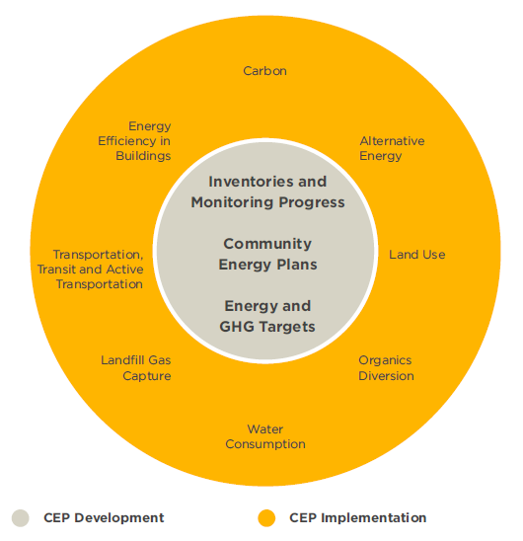
What is Community Energy Planning?
CEPs are often led by municipal government, and implemented by the community, including:
Most local government departments
Elected officials
Utilities
Real estate sector
Large energy users
And others
CEPs typically contain:
Energy and emissions inventory
Energy and emissions reduction targets
Broad scope of actions
Notes:
While CEPs are led by municipalities, it requires a range of stakeholders to get from setting objectives/targets to developing and implementing a detailed plan
When engaging staff, stakeholders and working with Council to begin developing a CEP, questions about the contents and logistics may be raised. Here are some things to consider before getting started:
General Outcomes/Deliverables (Goals & Vision)
Identify what the CEP aims to achieve:
integrates energy into municipal planning processes
supports environmental goals as part of a GHG reduction strategy
enhances energy efficiency in the municipal corporation or in the wider community;
develops specific actions that support a broader sustainability strategy in your municipality
Time frame
Is this a ten or twenty year plan? Will it be reviewed every 5 years like an Official Plan or does it correspond to the time frame in other key City documents like the strategic plan or the business plan?
Scope
Decide which sectors will be included in the CEP - consider residential, commercial, institutional, industrial, agricultural and transportation sectors.
Stakeholders
Identify key energy-related stakeholders that can provide information, resources, strategy direction and technical support to the project.
Other: Available funding, other resources, work team, project leadership within the municipality, framing the narrative (By discussing and documenting these key considerations your team will have framed a narrative and developed a vocabulary for talking about energy in your community. This narrative can become the basis for the key messages that will frame the communications strategy for the CEP.)
(Source: Community Energy Planning in Ontario: A Primer, 2013)
http://www.questcanada.org/primer

Slide 6
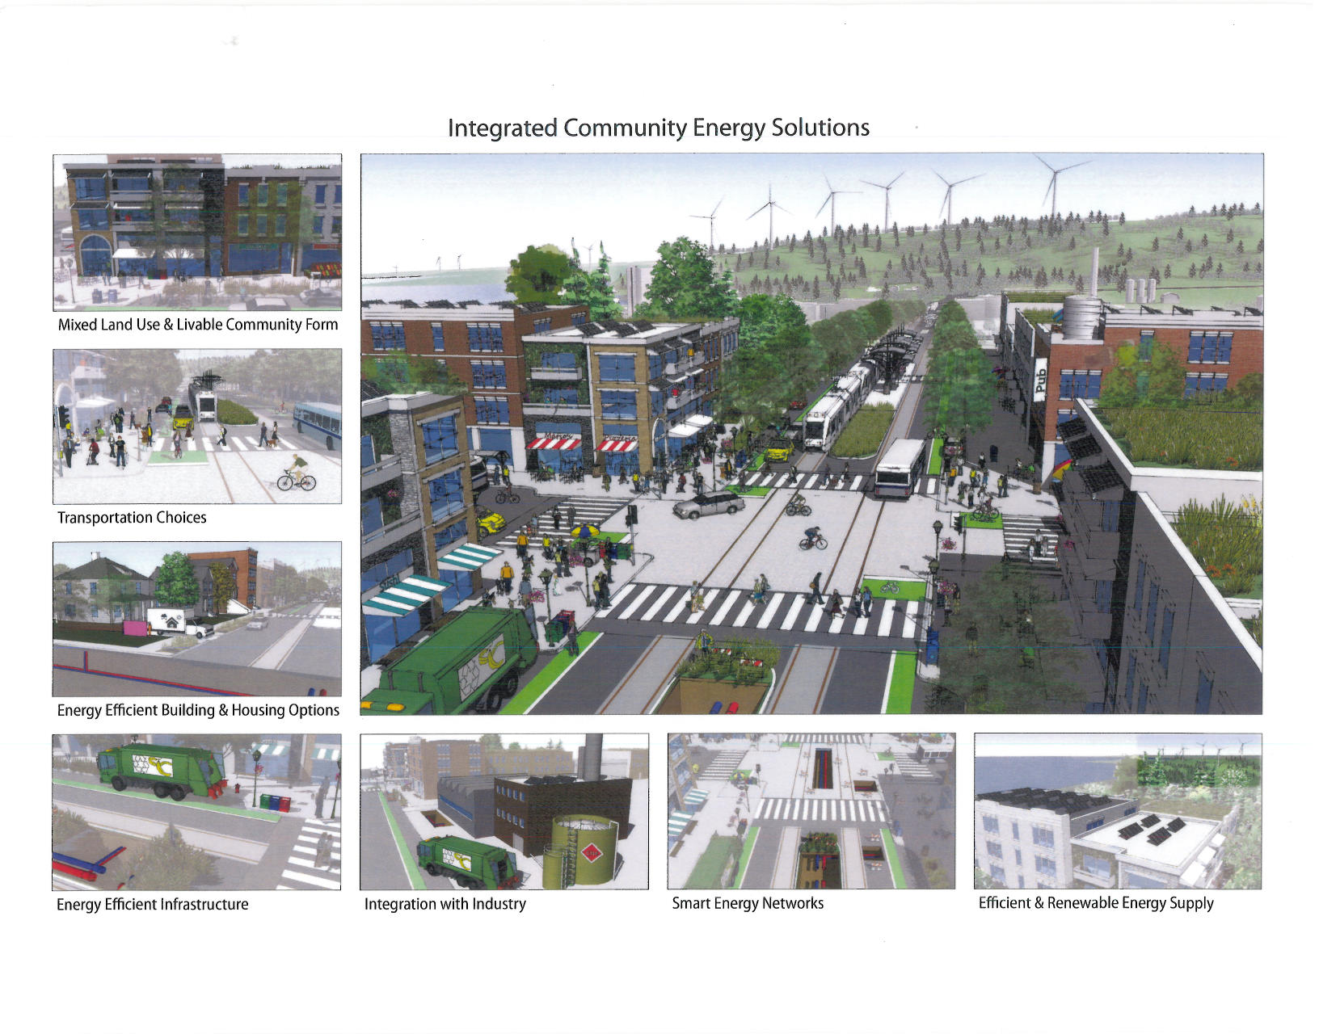
Why develop a Community Energy Plan?
Notes:
Image Source: Natural Resources Canada
This image is from NRCan and speaks to the vision of many CEPs – thriving, vibrant communities that make smart energy decisions. I will take a step back and go over where Canadian cities are today and talk about why we need Smart Energy Communities.
We know that Canadian communities are major consumers of energy, and emitters of GHG emissions
What’s really startling is that over the last decade, energy demand in communities has risen by nearly 20 percent in Canada. If we continue to do produce and consume energy the way we do today (by the choices we make about how we move around, our buildings, our land use choices), business-as-usual scenarios show that energy consumed in communities could increase by 75% by 2050 (compared to 2006 levels).
What this trend translates to are not only a significant environmental impact through heightened GHGs and consumption of more resources, it also has significant economic, social and health impacts as well which I think are just as important to speak to as the climate impact that would have.
Another important point to make is that in Canada energy planning, has traditionally been the purview of the provinces, but with increasing urbanization, growing distributed generation opportunities, we’re seeing growing pressure placed on communities to include energy considerations in their core mandate

Slide 7
Who has Community Energy Plans?
Guelph, London, Halton Hills, Burlington, Oakville , Vaughan, Newmarket (council approved and in implementation phase)
Markham, Chatham-Kent, Kingston, Temiskaming, Wawa, Windsor, Woodstock (In development)
CEPs required for growth nodes in York Region
CEPs required for Partners for Climate Protection (PCP) Campaign Milestones. 61 Ontario PCP Municipalities
Ever increasing momentum and recognition of CEPs as a mechanism and tool to further prosperous and livable communities

Slide 8
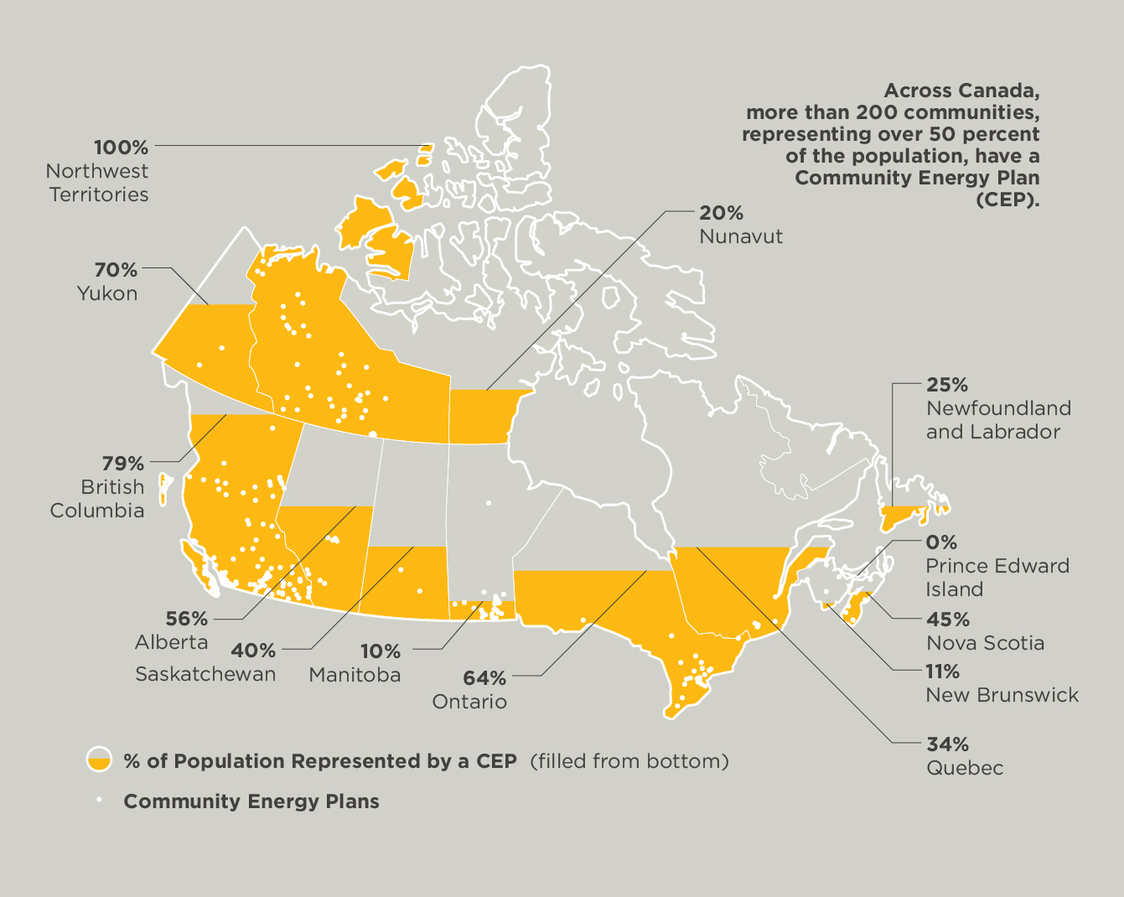
Across Canada, more than 200 communities, representing over 50 percent of the population, have a CEP
Notes:
Image Source: www.gettingtoimplementation.ca

Slide 9
1.2 Applications of a Community Energy Plan (CEP)

Slide 10
Energy Serves as a Connector
EFFICIENCY
LIVEABILITY
LOWER COST COMMUNITIES TO BUILD AND SERVE
ENERGY
HEALTH
FLEXIBILITY & RESPONSIVENESS
COMPETITIVENESS
Notes:
One of the key benefits that comes from CEPs is the ability energy has to be a connector of a variety of different policy and strategic goals as energy plays a factor in each of these areas and provides a mechanism for connecting these various goals together.
Many municipalities recognize the opportunity that can be achieved by better integration of their various plans and energy is able to support that integration. This enables the energy lens to provide greater benefit to the planning process. For that energy lens to work it needs to be integrated into other planning processes and in that way, the CEP process can help support integration and identify synergies/potential conflicts between the goals of the various municipal plans.

Slide 11
Who is Engaged in Community Energy Planning?
Municipalities plan so they can build better communities
Official Plans, Strategic Plans, Transportation Plans, Economic Plans, Environmental & Sustainability Plans, Health Plans, etc..
Energy planning is a new lens that can enhance municipal planning and community building
New & emerging technologies enable an energy system that has the ability for energy needs to be provided at a more local scale
Notes:
Municipalities are very actively engaged in the planning process, it’s what municipalities do.
So energy planning is not something new to a municipality, community energy planning is simply a new lens that is added on to an already existing process.
While past energy planning may have simply consisted of “hooking up to the grid”, emerging energy systems provide significant more opportunities to meet energy needs in a more diversified and often more local scale approach than past energy systems offered. This has opened up a whole host of new energy opportunities to municipalities and communities and this trend is only likely to continue to grow exponentially.
One simply needs to think of how fast energy technology is advancing and the opportunities that diversified energy generation and energy storage technologies will offer to the market place over the coming years. Think of the impact that Tesla and other home energy storage systems will have on the energy opportunities as they advance in the marketplace.
This isn’t an either/or approach between more centralized energy generation distributed via the energy grid and an independent energy source, this is about diversifying options and finding the approach that works best for individual entities (be it a big industry, a commercial enterprise, or a specific development or individual) as well as the collective users of the overall energy system.

Slide 12
Energy Reduction Targets
Many CEPs have set out energy reduction targets:
Many aligned with the IPCC & Ontario’s GHG reduction targets of: 15% reduction from 1990 levels by 2020; and 80% reductions from 1990 by 2050.
As part of the Partners for Climate Protection Campaign setting a target is one of the 5 milestones. 61 Ontario Municipal Councils signed on to the PCP Campaign.
CEPs implementation section identifies what % of target each of the identified actions will achieve. (ex. Buildings, transportation, land use, waste, etc)
Notes:
Each community will go about setting their target in different ways. Some of the factors that can provide direction is to align your CEP with set targets from other levels of government, especially those governments that greatly influence energy within the community (such as the Province of Ontario) and international standards and targets (IPCC).
It can also be helpful to factor in the targets that have been set for stakeholders within your community such as utilities.
It is also good to provide clarity on the implementation strategy of estimates on how much reduction will likely be able to be achieved via the actions within the CEP and the contribution that action makes to the overall target. This ensures accountability and measures progress and clearly delineates what role the CEP will play in contributing to the overall energy use/GHG reduction target.

Slide 13
Developing a CEP: Data Sources & Analysis
Electricity use (from LDC)
Natural Gas Use (from gas utility)
Transportation (gas sales, transportation counts, vehicle ownership, GIS data on vehicle trips)
Information on where the energy used comes from and coefficients
Possible perspectives: sectoral, geographical, energy type, economic, future scenarios
Notes:
One of the first steps to developing a CEP is to understand how energy is used within your community right now and how it is likely to be used in the future
Opportunities can be identified by looking at this information from a variety of different perspectives. Looking at this information in isolated pieces will not be nearly as enlightening as looking at it and communicating it from a variety of perspectives.

Slide 14
Developing a CEP: Energy Reduction Actions
Planning & Policy (ex. intensification, growth nodes, green development standards, incentives, true cost accounting, natural capital value & asset management
Public & Active Transportation, TDM , driver training, anti-idling, low carbon vehicles
Public & Stakeholder Outreach & Engagement
Energy Efficiency in Existing Buildings
Solid waste, landfill gas, compost
Renewable, district, CH&P energy
Water Conservation & Efficiency
Notes:
While there is no such thing as a cookie cutter CEP there are a variety of actions that often are highlighted and explored as part of the CEP process and again the data and the stakeholder process can facilitate the discussion and decision making process for what makes the most sense for the community priorities.
Presenter note: This can be expanded on within slide 19 -23. Or removed and then Slides 19 – 23 can be used in its staid.

Slide 15
Municipal influence on energy & GHGs
Communities account for 60% of Canada’s GHG emissions… Expected to grow to 75% under BAU
Municipal corporation direct emissions = between 5 – 10% of GHG
BUT, Municipalities have indirect control over 40% of GHG emissions
How communities are planned has an enormous influence on how much energy is used
Notes:
Municipalities have significant influence over how much energy their community uses.
Canadians are one of the world’s most urbanized peoples. 80% of the Canadian population lives in urban/suburban communities.
For example from a recent Sustainable Prosperity report on land use planning it was found that suburban drivers have 3 times the transportations emissions is comparison to urban drivers. Low density and separated land use make it more much more difficult and expensive to provide quality transit and AT opportunities that can meet their transportation needs leading to a higher predominance of vehicle use in suburban areas in comparison to more urban areas.

Slide 16
Community GHG Emissions under Direct and Indirect Control or Influence of Municipal Governments – Canada Wide
GHG Type
Direct Control | Municipal Operations | 1%
 | Landfill Gas | 5%
 | Residential Waste | 4.4%
Indirect Control | Management/Influence over Institutional /Commercial /Institutional Waste | 13%
 | Residential Buildings | 23%
 | Commercial and Institutional Buildings | 13.6%
 | Industry | 8.6%
 | Personal and Freight Transportation (excluding rail, marine and off-road) | 30.5%
Total | % of Canadian GHG emissions under municipal direct and indirect control or influence | 44%
Notes:
From this chart you can see where municipalities directly control and where municipalities have influence (indirect control). This is taken from a national study undertaken by FCM (Act Locally: The Municipal Role in Fighting Climate Change).
When an analysis was undertaken in Ontario based on the energy use pie chart that was in the MOECC’s Climate Change Discussion Paper it was found that 60% of Ontario’s GHGs originate in urban/suburban cities.

Slide 17
Do any of the Below Priorities Speak to You?
Energy savings to reduce municipal costs
Energy costs for the community - Where energy costs go
Reducing municipal, business and residents vulnerability to energy price increases
Alignment with Official Plan, Strategic Plan, Climate Change Action Plan, Community Sustainability Plan, Transportation Plans, Green Development Standards, etc…
Job creation from energy efficiency, energy generation and associated products and services
Energy security to promote economic competitiveness
Energy limitations and growth
Energy resilience
Opportunities to use waste heat or provide district energy
Solar, wind, combined heat and power opportunities
Notes:
There is a wide variety of benefits resulting from CEPs that there is likely to be something that resonates with the various stakeholders that will need to be involved in order to further the successful development and implementation of a CEP.
The important thing to factor in is that different benefits will speak better to various stakeholders. Utilities are likely to be more interested in efforts that help them meet their CDM targets, residents will like opportunities to reduce energy costs and improve air quality, environmental groups will be interested in greenhouse gas reductions and supporting the movement to a lower impact source of energy, boards of trade and chambers of commerce will likely be interested in local economic development opportunities resulting from energy savings, local generation of energy and the fostering a local energy service cluster.
It’s important to not simply focus on only one benefit but speak to all of them and place greater emphasis on the benefits that are likely to resonate most with that stakeholder.

Slide 18
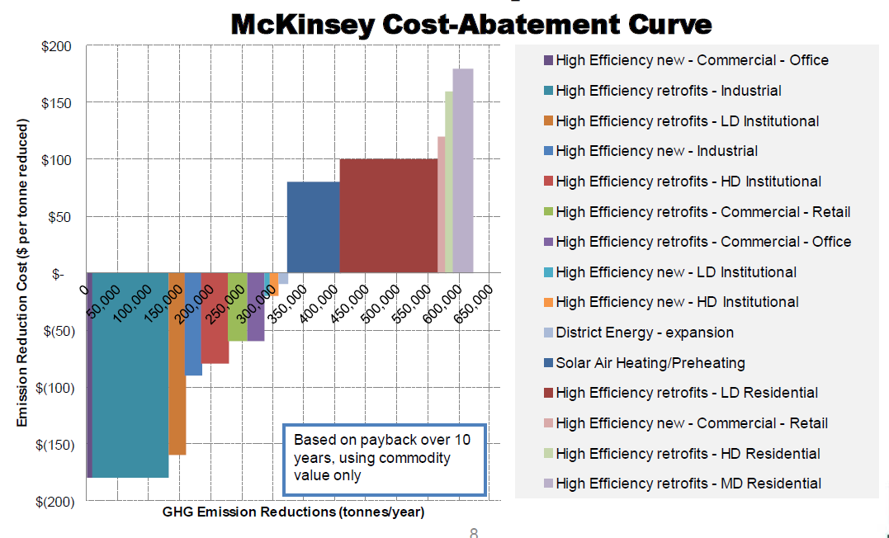
Economics of Energy Use & Energy Savings
Significant amount of community dollars are spent on energy.
Significant opportunities for energy saving opportunities exists within our communities.
Many community energy reductions can be achieved at an impressive rate of return on investment.
Notes:
When looking at the range of energy efficiency opportunities it is important to note that many of the most cost effective ones are available within our communities.
This is a generic chart outlining the range of cost reduction opportunities based on communities across Canada. One of the goals of a CEP is to develop a better understanding of the best opportunities available within your community.

Slide 19
1.3 Benefits of Community Energy Planning

Slide 20
Community Energy Planning: A Critical Pillar for Achieving Local Objectives
Notes:
Many of the people in the room will be able to tell you that CEP implementation can lead to a tremendous number of community benefits that extend beyond GHG reductions.
As part of the GTI initiative, we produced a report that shows the many economic benefits of community energy planning. From reducing the millions – and in some cases billions – spent on energy each year and recirculating that back into the local economy. From the health side, demonstrating reduced health care costs associated with improved access to public and active forms of transportation. And on the resilience side, finding solutions that help reduce the risks of rising and fluctuating energy costs.

Slide 21
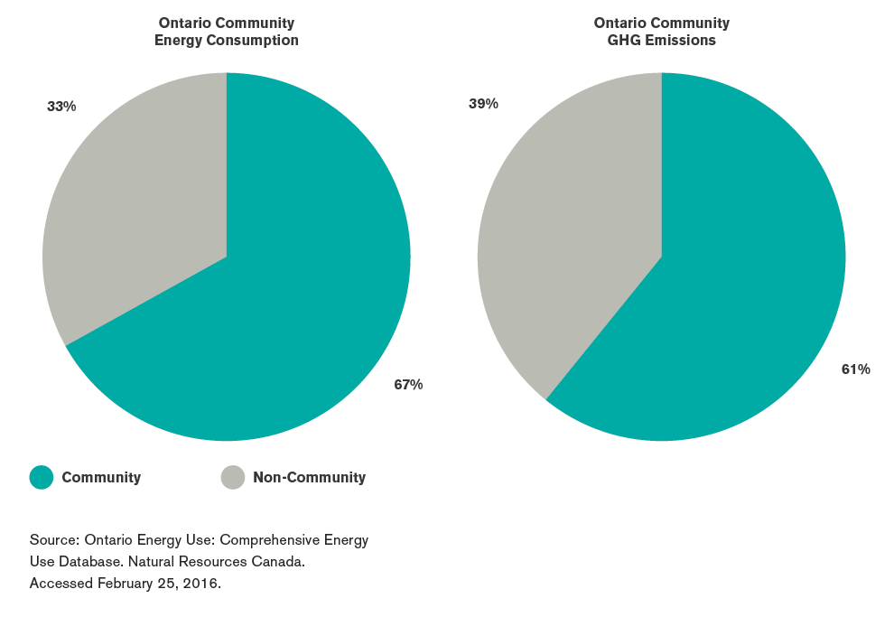
Municipal Influence over Energy and GHGs
Ontario communities influence more than 65 percent of energy use and over 60 percent of GHG emissions.

Slide 22
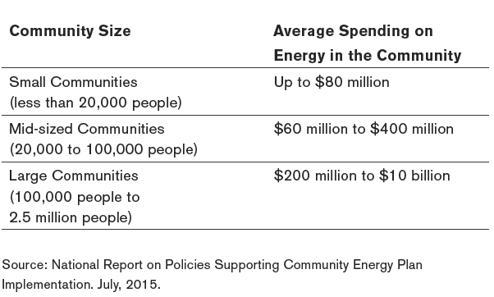
Energy Spending in Communities is High
Energy spending ranges from approximately $2,000-$4,000 per capita annually.

Slide 23
Energy Spending in Ontario Communities is Growing
% Growth in Energy Spending 2008 to 2031
Notes:
Percent growth in expected cost of energy, community-wide, : Three cities
There is also uncertainty around how carbon pricing might impact energy spending at the community level. Some municipalities and businesses are incorporating anticipated (or “shadow”) carbon pricing levels into their forward-looking planning to make major investments resilient to any future pricing of carbon.
Furthermore, energy prices are volatile. This risk can be hedged by reducing energy costs thorough energy conservation and efficiency, and harnessing opportunities for local energy sources.

Slide 24
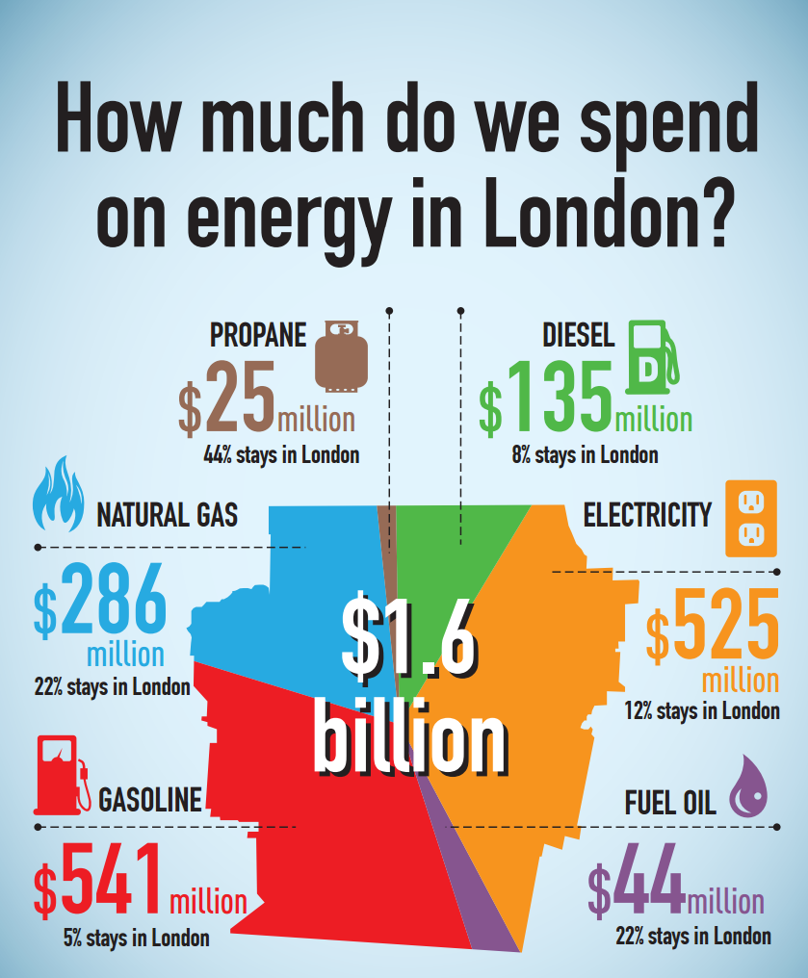
Example: Energy Spending in the City of London, Ontario
See more infographics at: http://www.london.ca/residents/Environment/environmental-initiatives/Pages/Infographics.aspx

Slide 25
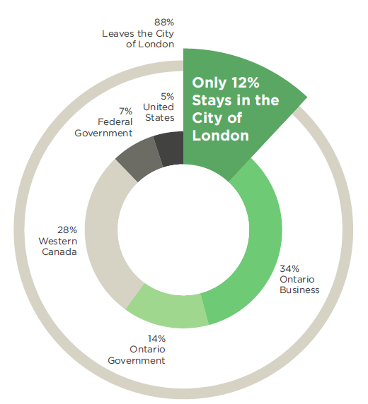
Example: Energy Spending in the City of London, Ontario
“Every 1% reduction in energy use by London residents and businesses prevents about $14 million from leaving the local economy.”

Slide 26
Potential CEP Energy Savings City of London, Ontario
Energy Cost Avoidance of Around $250 Million per year by 2018
Notes:
CEPs can enable communities to measure cost savings potential of a suite of energy actions.

Slide 27
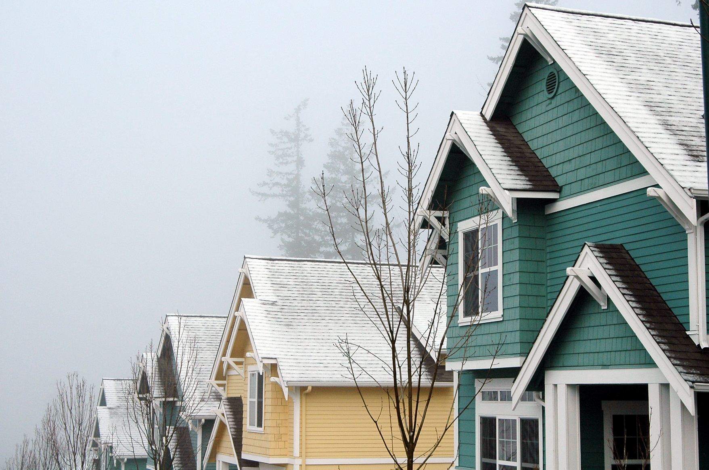
CEPs Encourage Energy Affordability
Energy efficiency
Distributed energy resources
Integrated land use and
transportation
Notes:
Energy efficiency upgrades can reduce for low/fixed-income residents
Alternative energy solutions can result in significant savings at the local level
Integrating land use and transportation can reduce the need for private vehicles – reducing spending on gasoline
Example: District energy systems can contribute to not only improved energy resiliency, but can also contribute to lowering the operating costs for local businesses. Some estimates reveal that the businesses and owners of buildings connected to district energy can achieve savings of nearly $3 per square foot a year on utility costs
Example: The Governments of Manitoba, Québec, Newfoundland and Labrador, The Northwest Territories, Yukon, and Ontario recently announced that they are establishing a pan-Canadian taskforce aimed at reducing the use of diesel to produce electricity in remote communities.
Example Horizon Utilities and Niagara Regional Housing Authority partnership

Slide 28
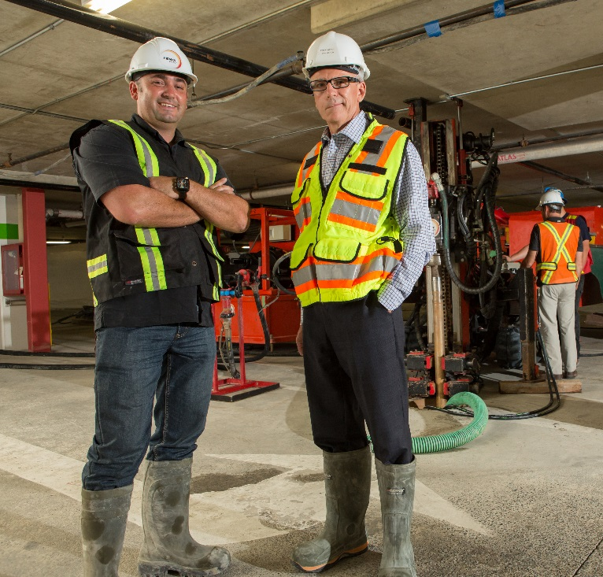
CEPs Facilitate Local Economic Development
Job creation
Attracting new investment and retaining local business
Economic benefits from integrated land use and transportation
Induced spending
Notes:
Creating jobs: Retrofitting homes & buildings, Green energy projects, Manufacturing products, Product & service providers, Professional services, Information tools & “apps”, Research & innovation
Attracting Local Investment and Retaining Local Business: // Example Polycon Car Parts In Guelph or Canadian Solar (Polycon parts connection to DE system saving 2 million per year or Canadian Solar selected to locate in Guelph area due to CEP) and the role that the CEP had in creating an economic investment strategy to attractive business
Economic Development as a result of improved integration between land use and transportation:
Induced Spending: As a result of residents having higher disposable incomes. Businesses reduced operating expenses. Induced spending benefits also includes increased spending as a result of more livable/walkable communities – increased local spending, reduced commute times. (e.g. NYC 1% of transportation budget on active transportation budget resulted in increased spending at local shops and businesses.

Slide 29
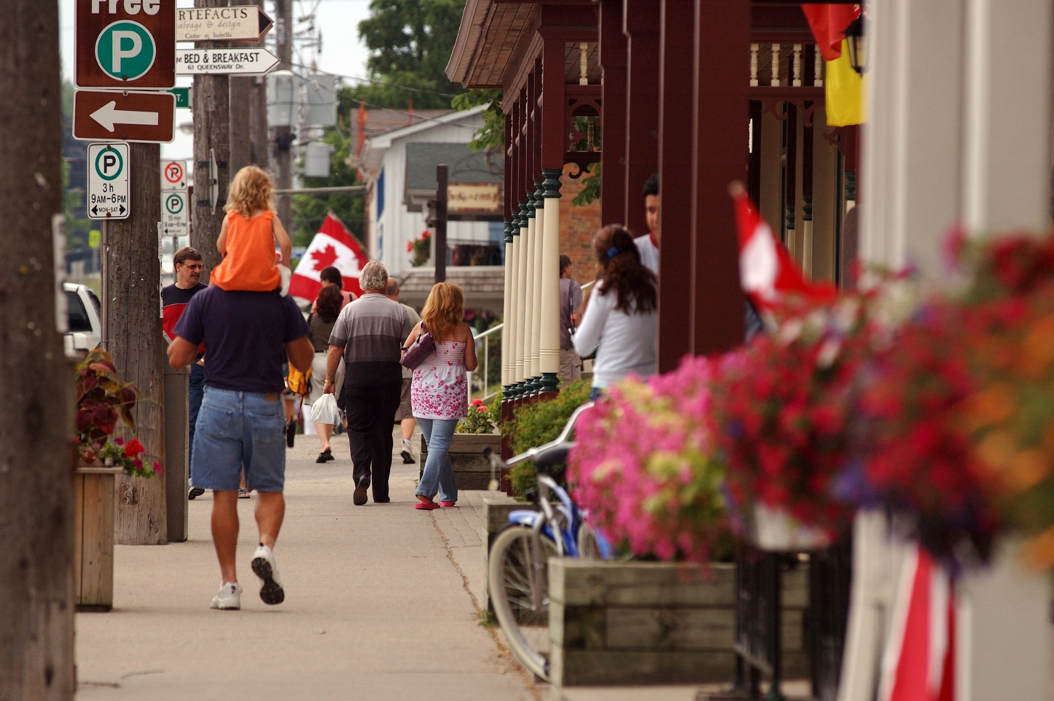
CEPs Enable Vibrant and Resilient Communities
“Copyright Queen's Printer for Ontario, photo source: Ontario Growth Secretariat, Ministry of Municipal Affairs and Housing”
Notes:
Vibrant: Redevelopment or renewal of a neighbourhood provides a unique opportunity to better integrate energy and land use, and can result in significant energy savings. Revitalization projects are increasingly aiming to create sustainable, liveable communities, designed for smarter energy management. Features include improved public transit, active transportation infrastructure, building design, integration between land use and transportation, and distributed energy resources.
Resilience: E.g. IBM moved their entire corporate headquarters and labs to Markham, Ontario in 2000, a move credited to the development of a local district energy system that provides clean, reliable, and affordable energy from multiple sources.
Resilient energy systems are also important in on-grid communities. The interruption or loss of energy supply from major natural disasters can leave wide areas without power for extended periods of time, including critical services such as hospitals, water pumping stations, and transit providers. This can create long term, negative economic impacts, as well as serious public health and safety risks. The Ontario ice storm in 2013, as with the Québec and Ontario ice storm in 1998, left millions without power for days in winter weather.

Slide 30
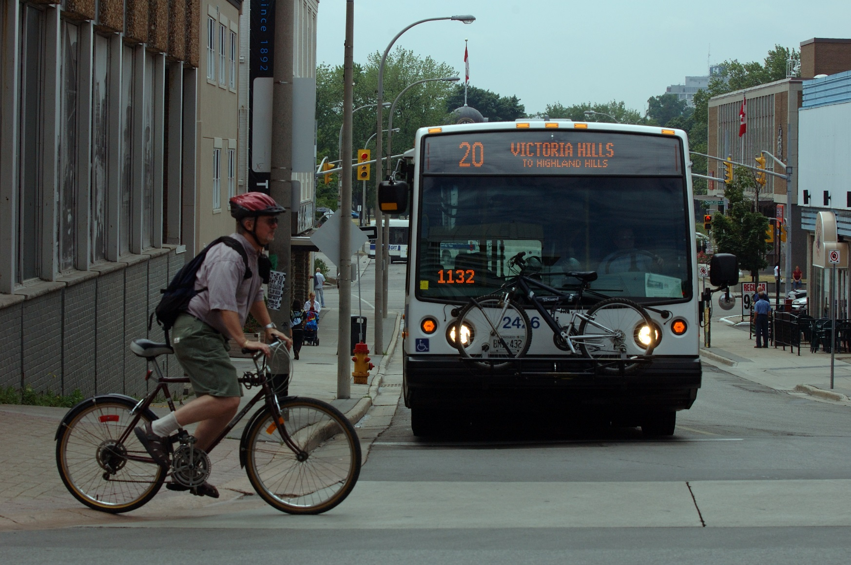
CEPs Can Help Achieve Health Goals
“Copyright Queen's Printer for Ontario, photo source: Ontario Growth Secretariat, Ministry of Municipal Affairs and Housing”
Notes:
Health benefits can arise as a result of :
Opportunities for active transportation
Improved air quality
Example: An evaluation of various scenarios for expanding light rail and bus rapid transit in the Region of Waterloo, Ontario, found that the project could lead to air quality improvements that could prevent from 31-61 hospital admissions and reduce costs of health care by $8.7 million - $16.6 million over 30 years.

Slide 31
Council & Senior Management CEP Priorities
Energy savings to reduce municipal costs
Energy costs for the community - Where energy costs go
Reducing municipal, business and residents vulnerability to energy price increases
Alignment with Official Plan, Strategic Plan, Climate Change Action Plan, Community Sustainability Plan, Transportation Plans, Green Development Standards, etc…
Job creation from energy efficiency, energy generation and associated products and services
Energy security to promote economic competitiveness
Energy limitations and growth
Opportunities to use waste heat or provide district energy
Solar, wind, combined heat and power opportunities
How the CEP fits in with Municipal and LDC CDM targets, Provincial Planning Framework, Regional Energy Planning (IESO), Province’s LTEP
Bring in case studies of what other communities have done and achieved.
Notes:
When speaking to the benefits and value of a CEP to various stakeholders it is important to recognize that each stakeholder will have their own priorities. For example some of the likely Council and Senior management priorities that can be furthered via a CEP include: List above

Slide 32
Why Bother? Because… CEPs enable
Significant opportunities for revenue generating/cost-effective generation, energy efficiency, conservation, demand management, etc.
Possible engagement in emerging carbon market, community reductions often cost-effective
Connections between disparate issues to be better integrated (electricity, thermal, water, waste, land use, infrastructure, growth management, municipal service costs, financial sustainability)
Significant health, social and economic benefits from energy saving and generation actions
Lower municipal costs, increased municipal revenue
Reductions in community vulnerability to energy price increases, energy disruptions, extreme weather events
Retention of more energy dollars within local economy
Greater participation in the emerging green economy, rather than simply being consumers of it
Notes:
The CEP process allows the municipality and the community to explore the following questions:
What is the direction the city is growing in?
How important is energy as a driver?
Are there limitations to energy supply?
Are there opportunities for efficiency and local generation, putting energy waste to work?
Does the City want to retain energy dollars for other uses?
Does the City want to tap into new sources of revenue?
Does the City want to use its assets in a more efficient way?
The question isn’t so much what your community can do for Community Energy Planning, but more about what Community Energy Planning can do for your community. And in many cases it can do a lot.

Slide 33
1.4 CEP Resources

Slide 34
Community Energy Planning Resources:
ECOP Resources
ECOP Module 2: Community Energy Planning within the Broader Provincial Energy Planning Framework
ECOP Module 3: Community Energy Plan Implementation
http://www.questcanada.org/events-projects/research/ecop
IESO Regional Planning Resources
http://www.ieso.ca/Regional-Planning/default.aspx
QUEST Resources
Community Energy Planning: http://www.questcanada.org/hub/community-energy-planning
Smart Energy Atlas: http://www.questcanada.org/hub/atlas
The Community Energy Implementation Framework
framework.gettingtoimplementation.ca
Other Resources
CEP Case Studies: London, Burlington, Markham, Guelph
Turning Energy Inventories into Energy Dollars Inventories
Notes:
These are additional resources that can be helpful in promoting and developing a successful CEP within your community.
For spreadsheet and tutorial for Turning Energy Inventories into Energy Dollars Inventories (send email to Gabriella at gkalapos@cleanairpartnership.org)

Slide 35
CEP Financial Resources
Ministry of Energy’s MEP Development Program:
Provides funding for 50% of costs to develop a CEP up to a maximum of $90,000
All municipalities are eligible including regional municipalities
Up to 2 years to complete
Stakeholder consultation process required
Ongoing intake, limited funding allocation
Ministry of Energy’s MEP Enhancement Program:
Funding to enhance plans (updating or drilling into data, implementation plans, energy maps, etc.)
50% of eligible costs, up to a maximum of $25,000
http://www.energy.gov.on.ca/en/municipal-energy/
Notes:
Covers the financial resources that are available to support municipal costs associated with the development of a CEP/MEP.
The possibility exists that the majority of municipal costs associated with the development of a CEP can be leveraged via these resources thereby greatly reducing the financial burden on the municipality.

Slide 36
CEP Financial Resources
FCM Green Municipal Fund: up to half of municipality’s costs to develop a CEP, up to a max of $175,000
Canada’s Gas Tax Fund: can be towards CEP (Capacity Building category): can be used to invest in planning projects that advance asset management and/or sustainability
Can be used for municipally owned energy projects (retrofits or generation)
Notes:
FCM’s CEP (needs to meet the requirements of the FCM PCP Milestones framework)

